Slide 1
Time Management

Slide 2
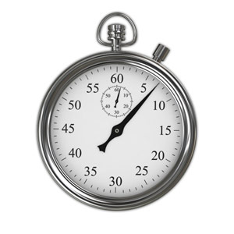

Slide 3
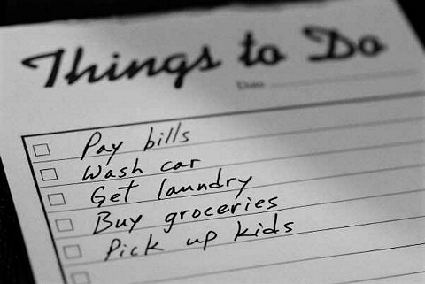
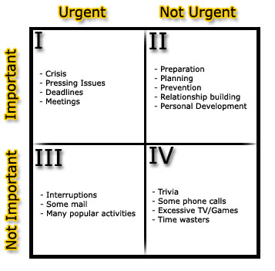

Slide 5
Generations
Four Generations
To Do lists
Calendars/ Appointment Books
Long, Intermediate, Short Range goals with Daily Planning
Urgency and Importance Matrix

Slide 6
The Time Management Matrix
 | URGENT | NOT URGENT
IMPORTANT | I | II
NOT IMPORTANT | III | IV

Slide 7
The Time Management Matrix
 | URGENT | NOT URGENT
IMPORTANT | I. Activities: Crises Pressing Problems Deadline-driven projects | II. Activities: Prevention, Health Maintenance Relationship Building Recognizing New Opportunities Planning, recreation
NOT IMPORTANT | III. Activities: Interruptions, some calls/texts Some e-mail, some reports Some meetings Pressing Matters Popular activities | IV. Activities: Trivia, busy work Some mail Some phone calls/texts Time wasters Pleasant activities

Slide 8
Crisis Managers
I Results: Stress Burnout Crisis Management Always putting out fires | II
 | IV
III

Slide 9
Urgency Slaves
I | II
III Results: Short Term Focus Crisis Management Reputation-chameleon Character See goals and plans as worthless Feel victimized, out of control Shallow or broken relationships | IV

Slide 10
Some McJobs
I | II
III Results: Total irresponsibility Fired from jobs Dependent on others for basics | IV

Slide 11
The Goal:
I | II Results: Vision, perspective Balance Discipline Control Few Crises

Slide 12
Personal Mission Statement
What you want to be?
What you want to do?
Based on personal values or principles

Slide 13
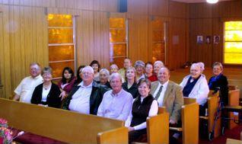
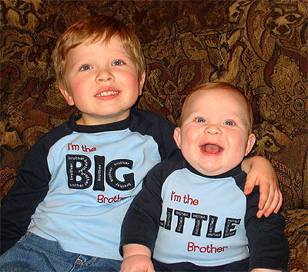
Identify Your Roles

Slide 14
Identify Your Roles
Athlete
Church Member
Parent
Health Care Provider
Sibling
Significant Other
Learner
Child
Individual
Teacher
Chief Resident
Caregiver
Friend
Pet Owner

Slide 15
Goals
Think of two or three important results for each role in next week
At least some should be quadrant II activities
Look at week ahead, schedule them in

Slide 16
MBTI and Time
The types revisited:
Intravert/ Extravert
iNtuitor/ Sensor
Thinker/ Feeler
Judger/ Perceiver
Can you think of any conflicts with time?

Slide 17
Judger
Scheduled
Organized
Planned
On time
Upset when people are late

Slide 18
Perceiver
Spontaneous
Sees possibilities
Prefers unscheduled time
Often underestimates how much time something will take
Wants to do one more thing before leaving

Slide 19
Intravert/Extravert
Thinking/ Planning Time
Management by Walking Around

