Slide 1
Acute Management of Ischemic Stroke in 2018:
Beyond tPA and New Guidelines _______________
May 17, 2018
Matthew Ehrlich, MD MPH
Assistant Professor of Neurology
Stroke Director, Duke Regional Hospital

Slide 2
Objectives
Review the burden of stroke in America
Discuss the history of acute stroke treatment
Briefly examine data behind tPA
Examine several trials’ data, both historically and very recently, regarding endovascular thrombectomy
Discuss how these trials shaped 2018 AHA Guidelines
Notes:
I will briefly touch on the mountains of data for tPA usage to gain historical perspective (but this is NOT a tPA talk, and is NOT all-inclusive of this data).
The meat of today’s talk will be the trial data on endovascular thrombectomy, both historically and then I’m going to spend a considerable amount of time on the DAWN trial that was just published last month

Slide 3
Disclosures
Off-label usage of Alteplase (tPA)
Several devices and manufacturers discussed; no affiliations or compensation
No personal compensation disclosures
Notes:
Other than some off-label tPA usage, the majority of this talk is strictly in review of published data; due to funding of many of these studies, they sometimes use one device over another – obviously that does not equate to my support nor reflect my opinions on any one company, device or drug.

Slide 4
Impact of Stroke in the USA
795,000 strokes per year in the USA
5th leading cause of death in the USA
1 in every 20 deaths in America is from stroke
One American dies from stroke every 4 minutes
    Stroke occurs every 40-45 seconds
https://www.cdc.gov/stroke/facts.htm

Slide 5
Impact of Stroke in the USA:
A local flavor to the story
795,000 strokes per year in the USA
5th leading cause of death in the USA
1 in every 20 deaths in America is from stroke
One American dies from stroke every 4 minutes
    Stroke occurs every 40-45 seconds
  People born and raised in the “stroke belt” are 34% more likely to have a stroke than in other parts of the USA
https://www.cdc.gov/stroke/facts.htm

Slide 6
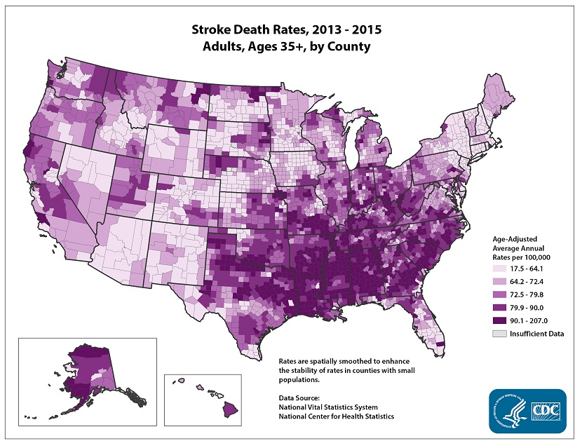
Impact of Stroke in the USA
STROKE BELT
https://www.cdc.gov/stroke/facts.htm

Slide 7
Impact of Stroke in the USA
A leading cause of long-term disability
    Decreases mobility in >50% of survivors >65yo
Cost to the US estimated at $34 billion each year
Risk of having a stroke is nearly twice as high for African Americans than for whites
  AA’s have the highest rate of death due to stroke
Hispanics’ death rates have increased since 2013
https://www.cdc.gov/stroke/facts.htm

Slide 8
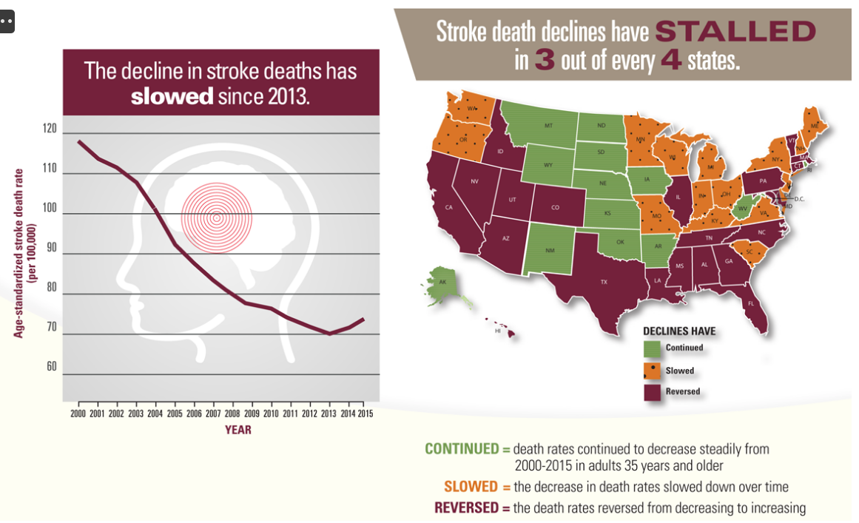
Impact of Stroke in the USA
Recent CDC data shows decades of stroke death rate declines have stalled or reversed
https://www.cdc.gov/vitalsigns/stroke/infographic.html#graphic

Slide 9

History of Stroke Treatment: Part 1
Notes:
In retrospect, this would have been a better title for my talk, as much of it will be historical perspective, in order to give an appropriate framework for the exciting new stuff in the last couple years of recent trial data

Slide 10
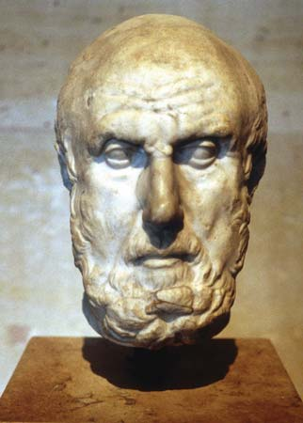
History of Stroke Treatment
Circa 400BCE: Hippocrates described Stroke.
“Apoplexy” – Greek meaning “Struck down with violence”

Slide 11
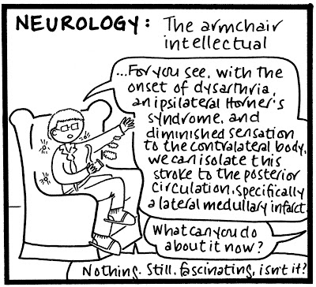
History of Stroke Treatment
400BC
The Dark Ages
Notes:
But following that, neurology did not gain any meaningful treatment for stroke for a really long time.
This is where the neurologist stereotype comes from: we were the armchair intellectual.
Cartoon: “for you see, with the onset of dysarthria, ipsilateral horner’s syndrome and diminshed sensation to the contralateral body, we can isolate this stroke to the posterior circulation, specifically a lateral medullary infarct. - What can you do about it now? -Nothing. Still, fascinating, isn’t it? “
I like to refer to this time as the Dark Ages.

Slide 12
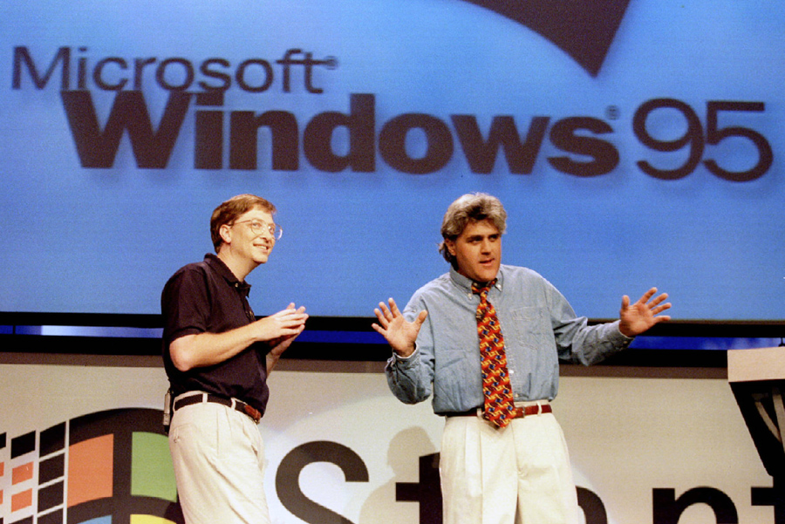
History of Stroke Treatment
1995!
Coolio’s Gangta’s Paradise was No 1
Braveheart won Best Picture
OJ Trial
Amazon sold it’s first book
Toy Story – the first computer animated film
Frappucino was released by Starbucks
eBay went live
400BC
1995
The Dark Ages
Notes:
Aaaand it turns out the dark ages for Stroke Neurology last until 1995**. Big year.

Slide 13
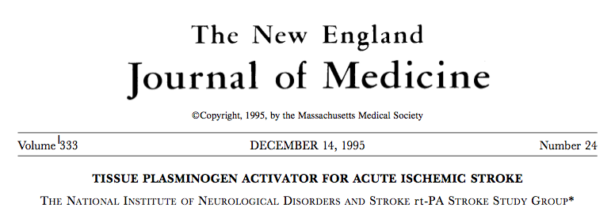
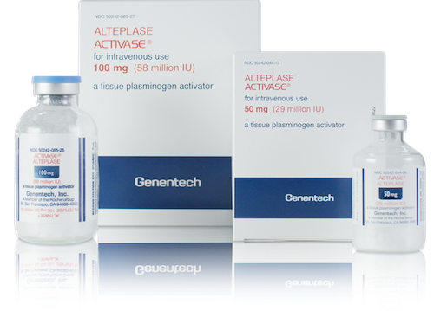
History of Stroke Treatment
400BC
1995
- NINDS Trial
The Dark Ages
Notes:
No, but really, this is when the NINDS trial was published showing efficacy for IV tPA for acute stroke.
Anecdote: I trained under Dr. EC Haley who had a big role in this trial. Was just honored with a Lifetime achievement award by the AHA/ASA at ISC conference last year. In his speech he reiterated that this was the most scrutinized, reviewed, examined and nit-picked dataset in the history of Neurology – and it always held up.
But this isn’t a talk about tPA (that’s another lecture)

Slide 14
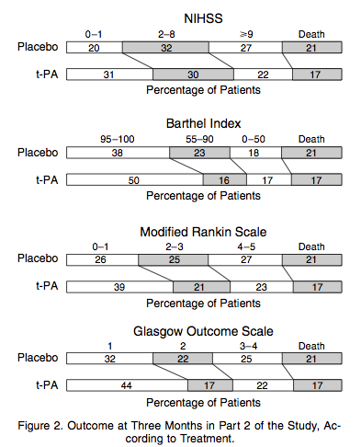
NINDS – The Highlights
Notes:
The bottom lines were this: At 3 months post stroke, tPA treated patients had lower NIHSS, lower Barthel Index, lower mRS, better Glasgow Outcome Scale
**This type of shift analysis graph looking at the mRS scores at 90 days essentially became the standard data presentation for stroke trails after the NINDs in 1995

Slide 15
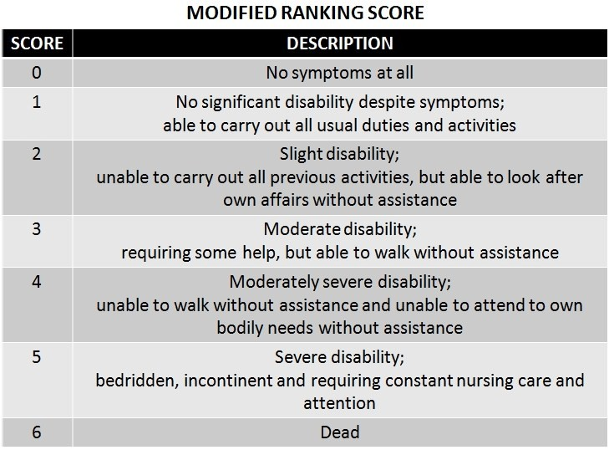
Modified Rankin Scale
Image: http://www.neuroems.com/2014/06/17/stroke-the-survivor/
Notes:
Real quickly let’s review the Modified Rankin Scale because this gets used as an outcome measure in every stroke trial.
This is a very granular, and very real-world measurement of disability
mRS scale (as used in all stroke outcomes studies), is ordinal and clinical differences between points are vastly different

Slide 16
Modified Rankin Scale
  mRS is ordinal and clinical differences between points are vastly different
  Has become standard measure, typically at 90 days, for all stroke trial outcomes
Image: http://www.neuroems.com/2014/06/17/stroke-the-survivor/
Notes:
Real quickly let’s review the Modified Rankin Scale because this gets used as an outcome measure in every stroke trial.
This is a very granular, and very real-world measurement of disability
mRS scale (as used in all stroke outcomes studies), is ordinal and clinical differences between points are vastly different

Slide 17
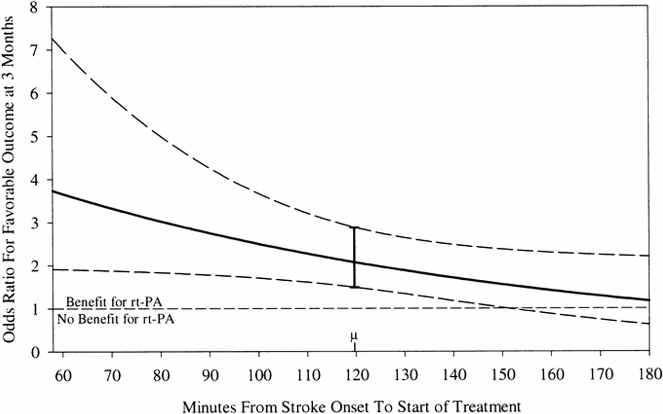
NINDS – The Highlights
1. Marler JR, et al. Early stroke treatment associated with better outcome The NINDS rt-PA Stroke Study. Neurology. 2000;55:1649–1655.
Notes:
Shown another way utilizing a logistic regression model, the data also showed that the earlier the patient is treated, the better the outcome (slope of the line)

Slide 18
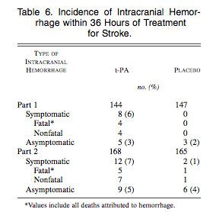
NINDS – The Highlights
1. Marler JR, et al. Early stroke treatment associated with better outcome The NINDS rt-PA Stroke Study. Neurology. 2000;55:1649–1655.
Notes:
With tPA there was a 6% Symptomatic hemorrhage rate. Asymptomatic hemorrhages occurred in both tpa and placebo arms, essentially in equal number.
This is the 6% hemorrhage rate that I quote to patients and families when giving tPA.
2.4 -8.8% depending on the study.
4.7% in GWTG review

Slide 19
A word on sICH
Symptomatic ICH
Estimates vary depending on trial examined
  Varying definitions
  SITS MOST and ECASS2 definitions best identify ICH that effects pt outcome
Modern review of GWTG data, 4.7% rate using NINDS definition

Slide 20
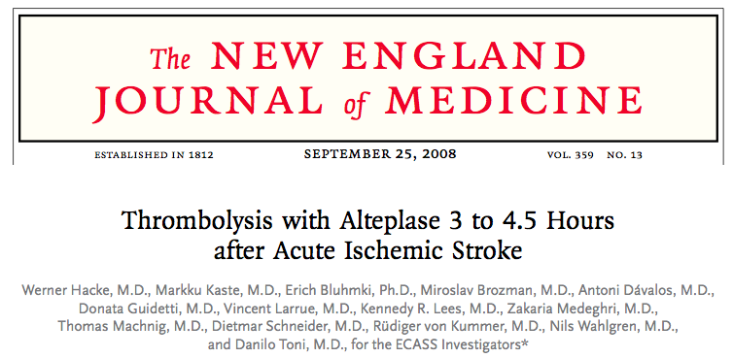
History of Stroke Treatment
NINDS Trial
ECASS III
400BC
1995
2008
The Dark Ages
Notes:
So, 1995 was huge. We spent the next dozen years scrutinizing tPA data, but realistically had nothing substantially new until 2008.
Animation**
This is when the ECASS III trial came out, examining the use of tPA in the 3-4.5 hours from LKN window

Slide 21
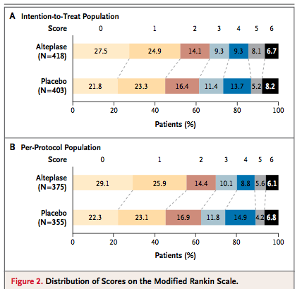
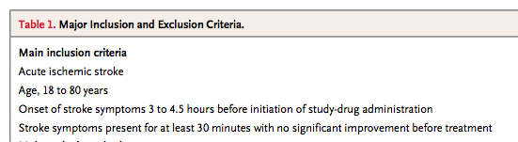
ECASS III – The Highlights
Notes:
Basically, if you select a little more carefully, tPA is effective out to 4.5 hours, with similar benefit as seen in NINDS

Slide 22
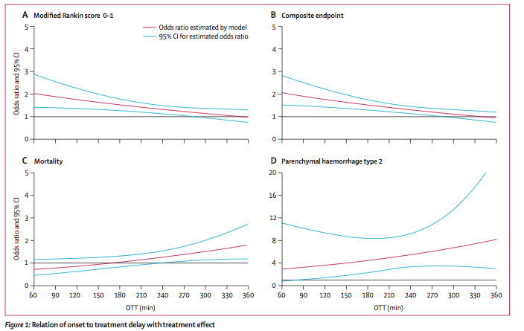
4.5 Hour Window
Lees et. Al. Lancet 2010; 375: 1695–703
Notes:
Multiple meta-analysis and reviews of the individual-level data from multiple trials of tPA repeatedly confirmed benefit in the 4.5 hour window.
HOWEVER, the FDA chose not to approve labeling for this window, so 3-4.5 hours is OFF-LABEL, BUT standard of care (in AHA/ASA guidelines)

Slide 23
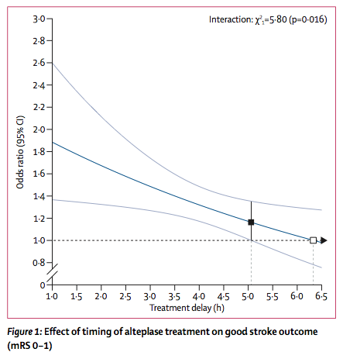
4.5 Hour Window
Emberson et. al. Lancet 2014; 384: 1929–35
Notes:
And as shown here, there may even benefit out to 5.1 (lower bound of the CI crosses 1 at 5.1 hours).
In this meta analysis, predefined subgroups analyzed were 0-3, 3-4.5, and >4.5h; tpa significantly improved chance of good outcome in first two predefined subgroups but not the latter.

Slide 24
Recanalization Hypothesis
Re-opening a vessel (acutely) should improve clinical outcomes in ischemic stroke.
Notes:
At this point, I need to pause and discuss an elephant in the room. The “WHY” we’re doing all this, which is the recanalization hypothesis.
This is the ASSUMPTION we all operate under.

Slide 25
Recanalization Hypothesis
Re-opening a vessel (acutely) should improve clinical outcomes in ischemic stroke.
…But does it?

Slide 26
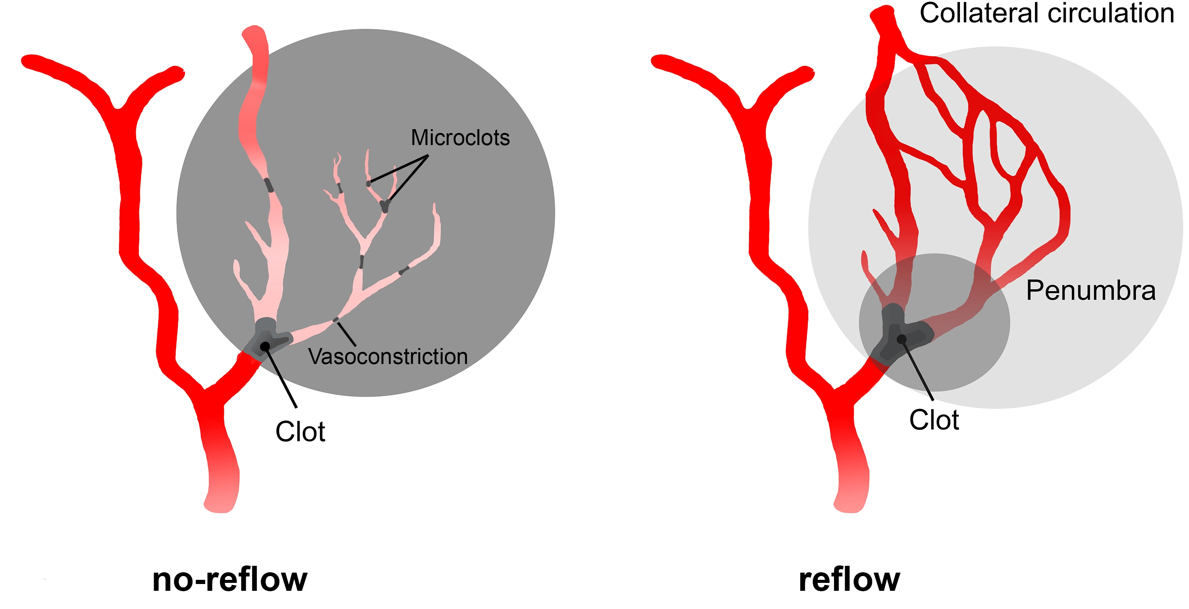
Recanalization Hypothesis
Several factors may weaken this assumption:
  Recanalization of large arteries may not be enough due to distal small emboli (no reflow)
Image: Amki and Wegener. Int. J. Mol. Sci. 2017, 18(12), 2669.

Slide 27
Recanalization Hypothesis
Several factors may weaken this assumption:
  Good collaterals may negate need to recanalize large vessel
Image: Amki and Wegener. Int. J. Mol. Sci. 2017, 18(12), 2669.

Slide 28
Recanalization Hypothesis
Several factors may weaken this assumption:
  Recanalization may occur too late to save tissue
  May cause Reperfusion injury, hemorrhage

Slide 29
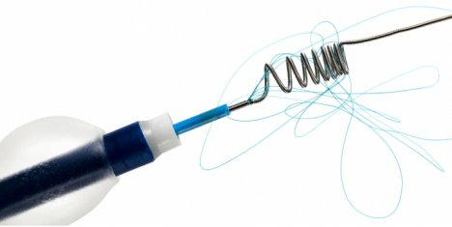
Recanalization Hypothesis
Despite this, recanalization on imaging has been used:
  as a marker of efficacy for small or early phase trials
  as a means for FDA approval of devices
Notes:
Early thrombectomy devices were approved after showing they could recanalize vessels well. Typically compared to historical tPA controls, and NO evidence showing improved outcomes in these early trials which resulted in approval of the devices by the FDA.

Slide 30
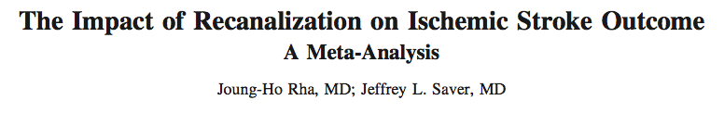
Recanalization Hypothesis
Stroke. 2007;38:967-973
Meta analysis in 2007 did suggest strong correlation between recanalization and stroke outcomes
Notes:
…so perhaps theres some truth to this assumption

Slide 31
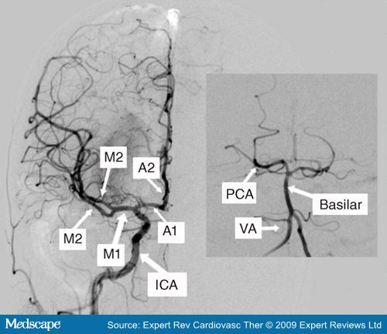
Recanalization Hypothesis
Recanalization rate with IV tPA: ~46%
  Varies by vessel
  Large vessels (ICA, MCA M1) seem to have lower rates
Rha and Saver. Stroke. 2007;38:967-973
Bhatia et. Al. Stroke. 2010;41:2254-2258
Notes:
Lower recanalization rate may also be due to the make up of the thrombus itself (more calcified? Fibrin content, etc)

Slide 32
Recanalization Hypothesis
So how can we improve recanalization rates in large vessel occlusions (LVO)?

Slide 33
Recanalization Hypothesis
So how can we improve recanalization rates in large vessel occlusions (LVO)?
Go get it.

Slide 34
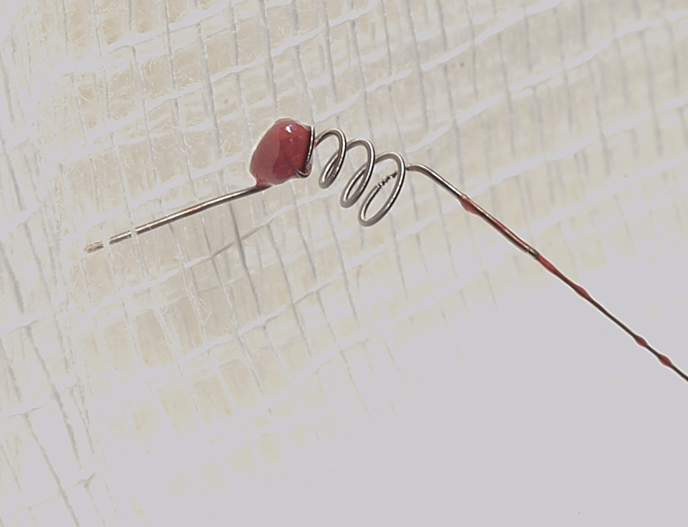
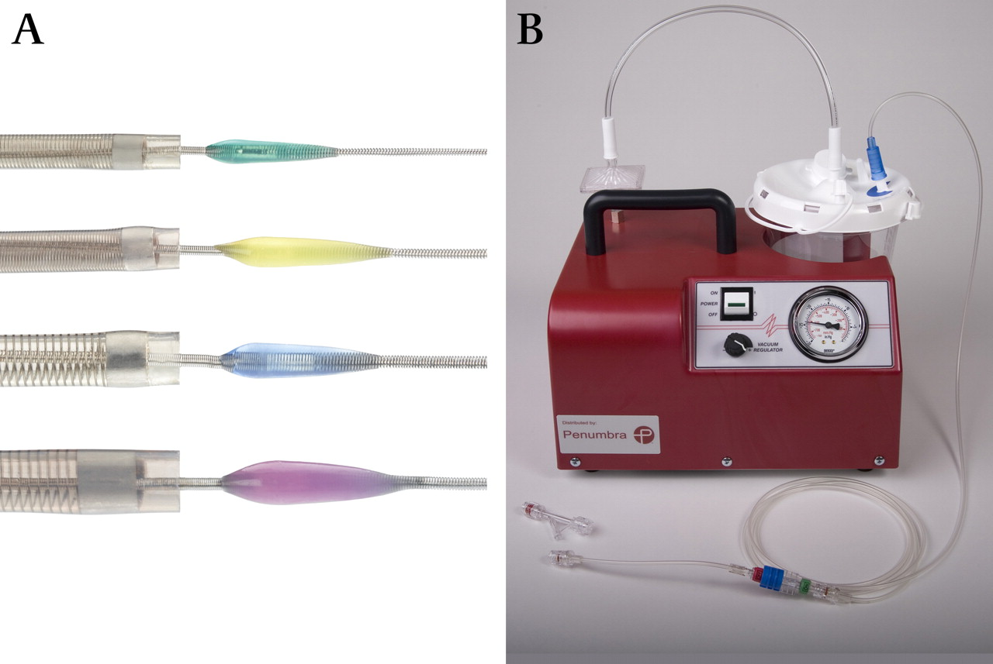
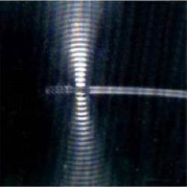
Endovascular Thrombectomy Devices
MERCI
(2004)
PENUMBRA
(2008)
EKOS Microinfusion catheter
(2005)
Notes:
So these devices get approved in 2004 – 2008. They can do the job they say they do, but there’s no evidence yet that that job improves stroke patients’ outcomes

Slide 35
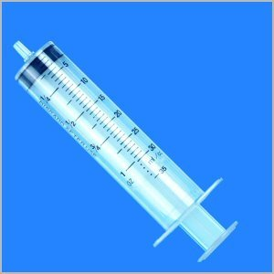
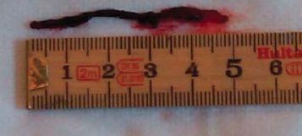
Endovascular Thrombectomy Devices
Notes:
There is one other device that a few guys I know use…

Slide 36
History of Stroke Treatment
NINDS Trial
ECASS III
400BC
1995
2008
2013
The Dark Ages
IMS III
MR Rescue
Synthesis
Notes:
2013 rolls around and three simultaneous publications come out in NEJM about these devices that are supposed to be exciting…
MR Rescue, IMS III, and Synthesis Expansion…and they’re all negative

Slide 37
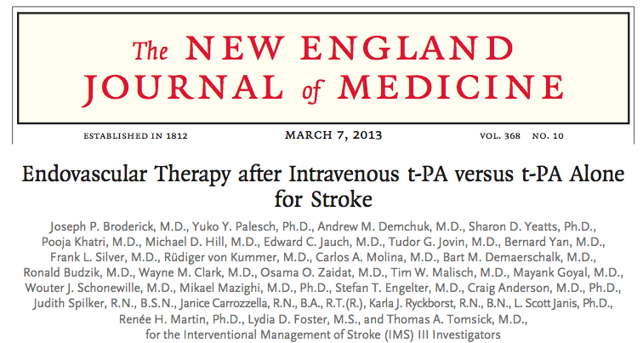
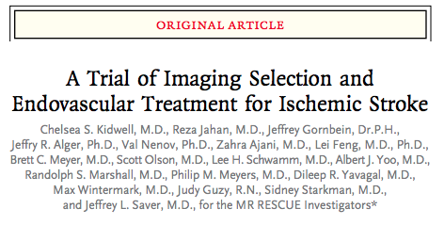
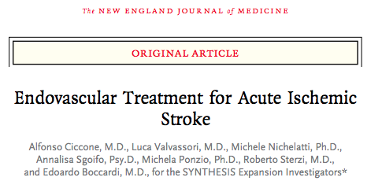
--------All Negative-------
Notes:
IMS III, MR RESCUE, and SYNTHESIS

Slide 38
Recanalization Hypothesis
Recanalization Rates with these protocols:
MR RESCUE: 69%
IMS III: 81% ICA, 86% M1, 88% M2
Notes:
Coming back to our recanalization hypothesis, did these devices and protocols work from a technical standpoint? Yes. But the outcomes were no better! Uh oh. Is our hypothesis wrong?
(Synthesis did not report recanalization)

Slide 39
2013 EVT Trials: post-mortem
Several weaknesses
  Long inclusion period: “outdated by the time they were published”
  Tiny number of patients per center per year
  Lack of pre-treatment vascular imaging (IMSIII, Synthesis)
    Notable percentage did not have LVO when they got to angio
  IV tPA vs EVT alone (IMSIII and MR RESCUE)
  Heterogeneity of EVT techniques/devices
    IA tPA, old devices
  Included low-NIHSS patients
  Inclusion window out to 8 hours (MR RESCUE)
Notes:
Is the hypothesis wrong? Maybe, maybe not…
Outdated by the time they were published: newer devices were coming out, imaging had improved, practices had changed
Randomizing as few as 2 pts per center per year
IV tPA vs EVT alone : rather than combined tpa and evt in the treatment arm
Old devices and IA tpa already outdated…
Low NIHSS patients do well regardless, making seeing a treatment difference impossible
Included patients way out from their stroke

Slide 40

History of Stroke Treatment
400BC
1995
The tPA Era
The Dark Ages
The Doldrums
Notes:
So here it is 2013, and If you boil down our timeline to significantly practice-changing events in acute stroke management, it looks like this. It had been almost 20 yrs since there was any change to practices
We messed around with existing data, some folks tried IA directed tPA, and a few other things – nothing groundbreaking, lots of negative trials, and very boring International Stroke Conferences every year

Slide 41
Endovascular Treatment Devices
MERCI
(2004)
PENUMBRA
(2008)
EKOS Microinfusion catheter
(2005)
OLD NEWS!
Notes:
**animation
Hold on, Matt. You said those trials were “outdated by the time they were published”.; that implies there was new stuff. What about the new stuff?

Slide 42
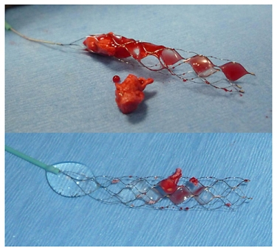
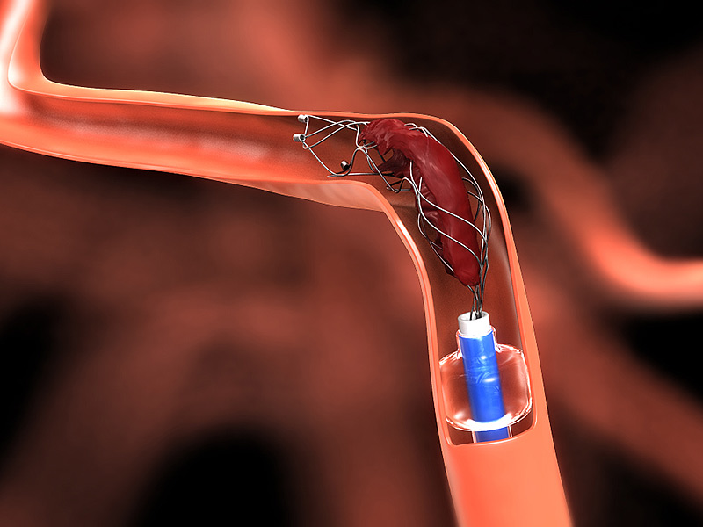
Endovascular Treatment Devices
Stent retrievers – Solitaire and Trevo
Superior to MERCI head-to-head
Faster, more effective reperfusion
Saver et al. Solitaire flow restoration device versus the Merci Retriever in patients with acute ischemic stroke (SWIFT): a randomised, parallel-group, non-inferiority trial. Lancet. 2012 Oct 6;380(9849):1241-9
Notes:
This is the new hotness
(Solitaire – medtronic
Trevo – Stryker)
Superior to MERCI device at recanalization*
Now also another device called MindFrame Capture by Medtronic

Slide 43
2015: ‘Stentrievers’ Make a Splash
SIX randomized clinical trials of EVT:
MR CLEAN (any approved device)
SWIFT PRIME (Solitaire)
EXTEND-IA (Solitaire)
ESCAPE (any approved device)
REVASCAT (Solitaire)
THRACE (2016)
Notes:
And in 2015, these devices made a big impact, along with better trial design
THRACE was late to the party

Slide 44
2015: ‘Stentrievers’ Make a Splash
SIX randomized clinical trials of EVT:
Addressed the short falls of previous studies
Used new generation devices
Faster treatment
More focused patient selection

Slide 45

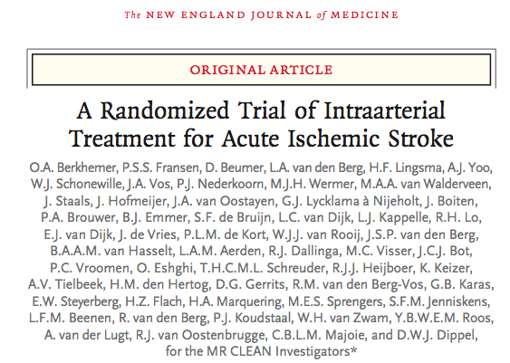
2015: ‘Stentrievers’ Make a Splash
‘Pragmatic trial’ conducted in the Netherlands
500 patients in 16 centers
EVT + standard of care vs standard of care alone
Treatment within 6h of stroke onset (Onset-to-groin puncture)
Confirmed proximal anterior circulation LVO (ICA, MCA M1 or M2, ACA A1 or A2)
NIHSS >2
Any approved device
No advanced imaging to identify stroke ‘core’ or ‘penumbra’
Adjusted common OR for shift in mRS (rather than dichotomized)
Berkhemer O, Beumer F, van den Berg L, et al. NEJM. 2015;372:11–20.
Notes:
Let’s take a closer look at these, because these are huge, and this is finally getting to the point of my talk! (ha!! – 46 slides in)

Slide 46
2015: ‘Stentrievers’ Make a Splash
Results:
  89% of all patients treated with IV tPA
  Median onset to IV tPA of 86 minutes (!!)
  81.5% of treatment arm patients treated with stent retrievers
  Median NIHSS 17/18
  90% of patients had pre-stroke mRS of 0-1 *
Berkhemer O, Beumer F, van den Berg L, et al. NEJM. 2015;372:11–20.
Notes:
Vast majority got tPA too
REALLY fast tPA treatment
Majority used stentrievers
Sick patients – NIHSS , LVO , duh
Healthy prior to stroke (baseline mRS)

Slide 47
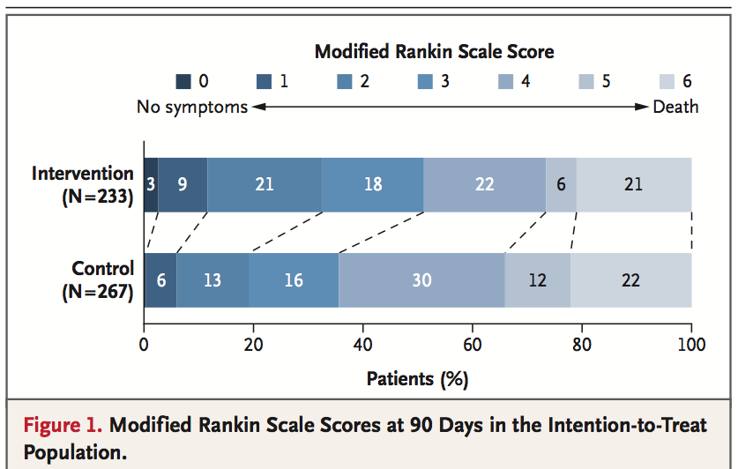
2015: ‘Stentrievers’ Make a Splash
  Adjusted common OR 1.67 (1.21 – 2.30) in favor of EVT
  32.6% vs 19.1% rate of functional independence (mRS 0-2)
  No difference in death or ICH rates
Berkhemer O, Beumer F, van den Berg L, et al. NEJM. 2015;372:11–20.
Notes:
Shift analysis

Slide 48

2015: ‘Stentrievers’ Make a Splash
Notes:
You guys don’t seem excited enough about this. This was huge. The first positive result for EVT and the first significantly positive stroke treatment trial in decades!

Slide 49

2015: ‘Stentrievers’ Make a Splash
Following release of the MR CLEAN results,
4 other ongoing trials halted for unplanned interim analyses.
SWIFT PRIME
EXTEND-IA
ESCAPE
REVASCAT

Slide 50
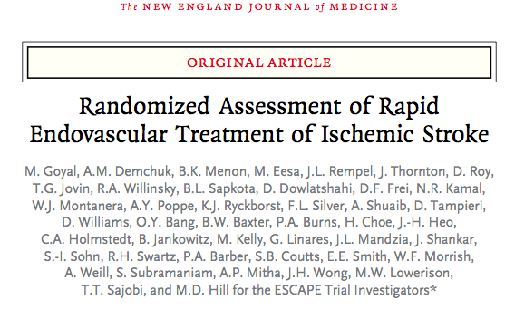

2015: ‘Stentrievers’ Make a Splash
PROBE design
316* patients in 22 sites in US, Canada, Ireland, South Korea
EVT + standard of care vs standard of care alone
Randomization within 12h (longest of the EVT trials)
Confirmed proximal anterior circulation LVO (ICA, MCA M1 or M2)
NIHSS >6
Any approved device (encouraged stentrievers)
Used more advanced imaging (ASPECTs score, collaterals on multiphase CTA used for selection)
Goyal M, Demchuk A, Menon B. NEJM. 2015;372:1019–30.
Notes:
Powered for 500 patients but stopped early
Longest onset to recruitment
Did not include ACA occlusions
NIHSS higher than MR CLEAN
Used multiphase CTA

Slide 51
2015: ‘Stentrievers’ Make a Splash
Results:
  75% of all patients treated with IV tPA
  Median onset to IV tPA: 117.5 minutes
  Median onset to reperfusion with device: 241 minutes (4hr)
  86% of treatment arm patients treated with stent retrievers
  Median NIHSS 16/17
Goyal M, Demchuk A, Menon B. NEJM. 2015;372:1019–30.
Notes:
tPA really fast
Reperfusion really fast
Vast majority used stentrievers
NIHSS – sick patients (LVO..duh)

Slide 52
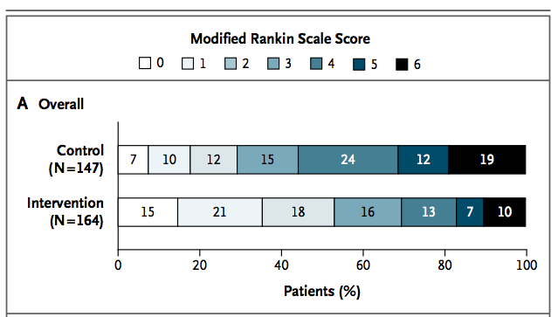
2015: ‘Stentrievers’ Make a Splash
  Adjusted common OR 2.6 (1.7 – 3.8) in favor of EVT
  53% vs 29% rate of functional independence (mRS 0-2)
  Reduced mortality
  No difference in ICH rates
Goyal M, Demchuk A, Menon B. NEJM. 2015;372:1019–30.
Notes:
Huge relative improvement in mRS at 90 days!
Only one to show reduced moratlity

Slide 53
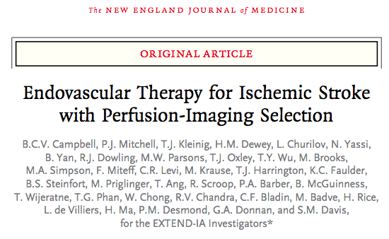

2015: ‘Stentrievers’ Make a Splash
PROBE design
70* patients in 10 sites in NZ and Aus
EVT + standard of care vs standard of care alone
Most stringent inclusion criteria
Solitaire device only
Required advanced perfusion imaging for patient selection (excluded 25% of screened patients on this alone)
Campbell B, Mitchell P, Kleinig T, et al. NEJM. 2015;372:1009–18.
Notes:
Stopped really early after unplanned interim analysis; efficacy shown with only 70 patients! Was powered for >1000
Perfusion imaging: evaluating for presumed salvageable tissue (infarct core vs penumbra)

Slide 54
2015: ‘Stentrievers’ Make a Splash
Results:
  Median onset to IV tPA: 208 minutes (3.4h – slower than others)
  100% of patients received tPA (by design)
  100% of treatment arm patients treated with Solitaire device
  Median NIHSS 13/17
Campbell B, Mitchell P, Kleinig T, et al. NEJM. 2015;372:1009–18.
Notes:
tPA a bit slower than others but still fast
Did not give onset to reperfusion times;
Sick patients – same as others
NNT is only 2.8!!!
MASSIVE relative improvement in independence

Slide 55
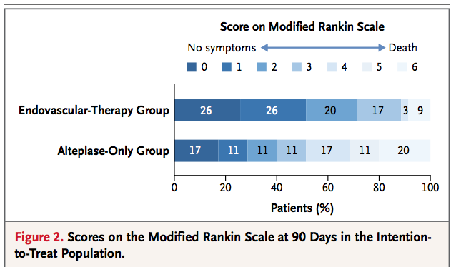
2015: ‘Stentrievers’ Make a Splash
  Adjusted OR 2.0 (1.2 – 3.8) in favor of EVT
  NNT 2.8 to achieve 1 point improvement of mRS
  71% vs 40% rate of functional independence (mRS 0-2)
  No difference in death or ICH rates
Campbell B, Mitchell P, Kleinig T, et al. NEJM. 2015;372:1009–18.

Slide 56


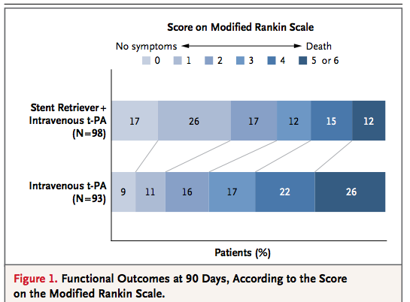
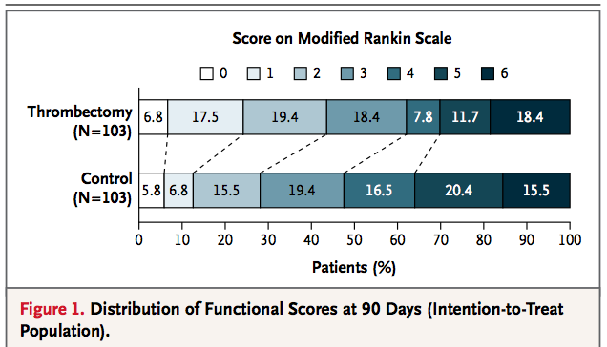
2015: ‘Stentrievers’ Make a Splash
60% vs 36% mRS 0-2
44% vs 28% mRS 0-2
Saver J et al. NEJM. 2015;372:2285–95
Jovin T et al. NEJM. 2015;372:2296–306.
Notes:
OK, you get the point, so heres the short version of the other two…
Swift Prime – US and Europe
Revascat– Catalonia Spain; probably weakest of all the studies

Slide 57
2015: ‘Stentrievers’ Make a Splash
HERMES collaborative pooled-analysis
  Combined these 5 using patient-level data
  Adjusted combined OR for mRS 0-2:
  2.71 (2.07 – 3.55); p < 0.0001
  NNT of 2.6, to reduce mRS 1 point
Goyal M, Menon B, van Zwam W, et al.. Lancet. 2016;387:1723–31.

Slide 58
2015: ‘Stentrievers’ Make a Splash
HERMES collaborative pooled-analysis:
  Faster is still better
Saver J et. al. JAMA 316(12);1279-1288
Notes:
Not only that, but meta analysis of data from these studies also confirmed that, just like IV tPA, faster is better (WHEN USING A TIME WINDOW)
You’ll also notice on this graph that the lower bound of the CI doesn’t cross 1 until 7.1 hours; though standard of care, and Duke protocols are only to treat if groin puncture can be achieved in 6 hours from onset/LKN

Slide 59

2015: ‘Stentrievers’ Make a Splash
Confirmed efficacy and safety of an intervention for acute stroke!
Now Standard of Care for AIS due to LVO

Slide 60
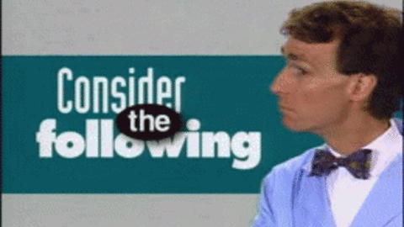

2015: ‘Stentrievers’ Make a Splash
  Few M2s included; very few ACA or posterior circulation occlusions included
Intervention control
Notes:
Not enough data on these other vessels to truly guide management

Slide 61
2015: ‘Stentrievers’ Make a Splash
  Low rate of distal embolization 8.6%, dissections 1.7%, perforations 0.9% (MR CLEAN data)
  Baseline function (?)
  Varying time windows used
  Varying use of advanced imaging techniques used
  Multiple cost-effectiveness analyses suggest despite the significant cost, it remains beneficial¹⁻³
1.Ganesalingam J, Pizzo E, Morris S, et al. Stroke. 2015;46:2591–8.
2.Leppert M, Campbell J, Simpson J, et al. Stroke. 2015;46:1870–6.
3.Xie X, Lambrinos A, Chan B, et al. CMAJ Open. 2016.
Notes:
All safety measures seem well within acceptable tolerances
Baseline mRS only noted in 1 of the studies (0 or 1), but this is included in the AHA guidelines now..

Slide 62
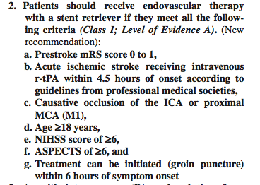
2015: ‘Stentrievers’ Make a Splash
AHA/ASA 2015 updated stroke guidelines to reflect new EVT data
Notes:
That same year, AHA/ASA updated their guidelines based on this robust data and essentially codified this as standard of care the same year it came out.
Lower level of evidence for other vessels (M2, ACA, posterior) and worded that it “is reasonable” to consider EVT in these patients

Slide 63
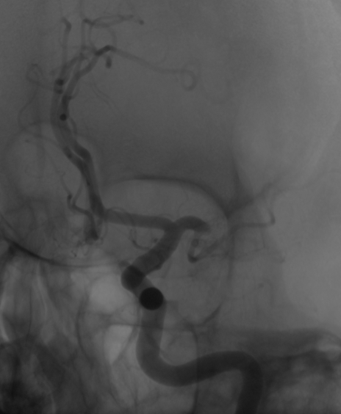
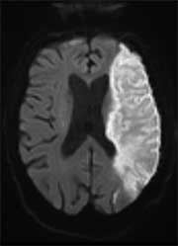
In Practice
Notes:
Left M1 occlusion; should produce this infarct…

Slide 64
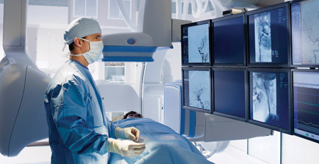
In Practice
Notes:
But if you let an interventionalist go retrieve the clot…

Slide 65
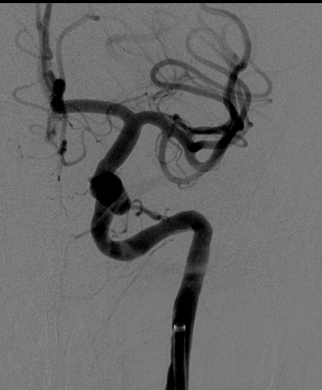
In Practice

Slide 66
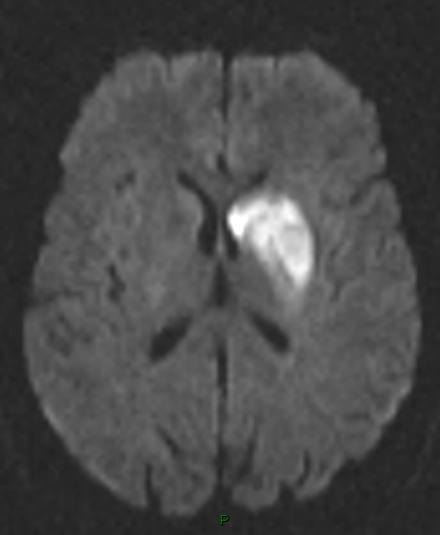
In Practice
Notes:
And this is a very very common MRI (DWI sequence) image after a successful thrombectomy case….

Slide 67
In Practice
Notes:
And this is a very very common MRI (DWI sequence) image after a successful thrombectomy case.
Instead of THIS (left image), we get this(right image) – the deep grey structures seem particularly susceptible and often have some scattered DWI signal but these patients do really well.

Slide 68
History of Stroke Treatment
MR CLEAN, et. al.
NINDS Trial
ECASS III
400BC
1995
2008
2015
2013
IMS III
MR Rescue
Synthesis
Notes:
Now that you’re all cross eyed from data, let’s revisit our timeline,….and add the new EVT trials (MR CLEAN, ESCAPE, EXTEND IA, SWIFT PRIME, REVASCAT)

Slide 69
History of Stroke Treatment
4.5h tPA window
EVT Works!
IV tPA
400BC
1995
2008
2015
2013
EVT doesn’t
work
Notes:
….and then convert all that to English

Slide 70

A New Dawn in Stroke Care
Notes:
Hot off the presses, and the big news this year is the DAWN trial. Published Nov 11 2017 in NEJM
“DWI or CTP Assessment with Clinical Mismatch in the Triage of Wake-Up and Late Presenting Strokes Undergoing Neurointervention with Trevo”

Slide 71
A New Dawn in Stroke Care
Driving factors for DAWN and DEFUSE3
  What to do with ‘wake up strokes’
  Signal in previous trials that EVT, in specific cases, may be beneficial later than 6h
  Imaging-exam mismatch
Can we identify patients who are likely to benefit from thrombectomy even a long time after their LKN?
Notes:
Wake up strokes – went to bed normal but awoke with deficits. Unable to clearly determine onset, and by its nature the LKN is likely to be several hours prior and out of window for standard treatments
There are instances when a patients exam is more severe than apparent infarct on imaging – can we identify these individuals and save oligemic, but not infarcted tissue.
Can we identify patients who are likely to benefit from thrombectomy even a long time after their LKN?
Theory: Patients with brain tissue that may be salvaged with reperfusion can be identified by the presence of a clinical deficit that is disproportionately severe relative to the volume of infarcted tissue on imaging

Slide 72
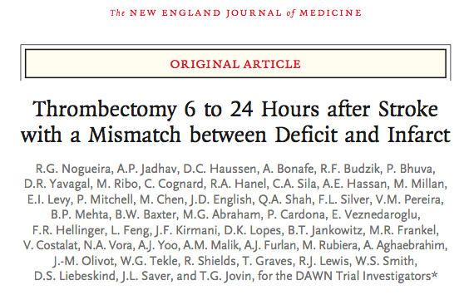
A New Dawn in Stroke Care
PROBE design
Patient selection:
  LNK 6-24h prior to randomization
  Premorbid mRS 0-1
  Imaging:exam mismatch
  Demonstrated occlusion of ICA, MCA M1 or both
  Stratified by age, NIHSS and infarct volume
 | Age | NIHSS | Infarct vol (ml)
Group A | >80 | >10 | <21
Group B | <80 | >10 | <31
Group C | <80 | >10 | 31-50
Notes:
Prospective, randomized open label, blinded end point design; 26 centers in US, canada, europe and australia
Late presentation or wake up strokes (>60% were classified as wake ups)
Minimal or no disability pre-stroke
Proximal large vessel only
“clinical mismatch” – NIHSS more severe than infarct volume would suggest. The theory being, in these folks, there is a significant amount of penumbral or threatened tissue that can be saved (oligemic/ischemic but not infarcted yet)

Slide 73
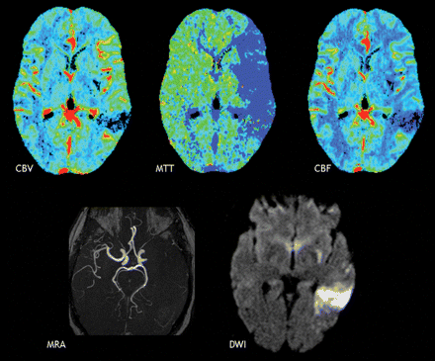
A New Dawn in Stroke Care
Infarct Volume determination
  CT Perfusion
  MRI DWI-sequence
Image: Wintermark AJR 2011
Notes:
Mostly by CTP, which required use of an automated software (RAPID IschemiaView) to quickly determine core infarct vs penumbral tissue and calculate volume. This software can actually send the images and calculations to designated practitioner’s phones.

Slide 74
A New Dawn in Stroke Care
Treatment
  EVT + standard care vs Standard care alone
  Trevo device only (funded by Stryker)
  Randomized 1:1
  Stratified by treatment group, time LKN, and occlusion location
Notes:
Mostly by CTP, which required use of an automated software (RAPID IschemiaView) to quickly determine core infarct vs penumbral tissue and calculate volume. This software can actually send the images and calculations to designated practitioner’s phones.

Slide 75
A New Dawn in Stroke Care
Results
  Stopped early at predetermined interim analysis
  206 patients
  Median NIHSS 17
  Median infarct volume 7.6 (EVT) vs 8.9 (control)
  Median LKN 12.2 vs 13.3 hours
  IV tPA administration 5 vs 13%
Notes:
Stopped early for EFFICACY at predetermined interim analysis; 31 months into study

Slide 76
A New Dawn in Stroke Care
Results
  ‘Utility weighted’ mRS: 5.5 vs 3.4
  Functional independence at 90 days: 49% vs 13%
  Death from stroke, Death (any cause), and sICH:
  No difference between groups
Notes:
Utility weighted scale – higher number is better; CI = bayseian credible interval

Slide 77
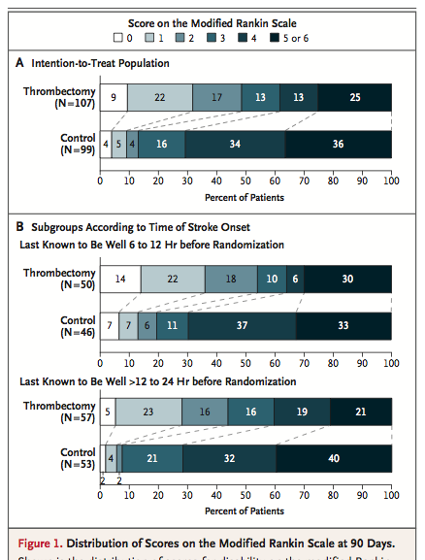
A New Dawn in Stroke Care
Notes:
By now you are used to seeing these plots. Again, these are impressive shifts in disability on a nominal scale w big clinical differences between categories

Slide 78
A New Dawn in Stroke Care
NNT 2 for 1 point mRS improvement
NNT 2.8 for mRS 0-2 at 90 days
Notes:
These are incredible NNT.

Slide 79
A New Dawn in Stroke Care
For every 2 patients who underwent thrombectomy, 1 additional patient had a better score for disability at 90 days
For every 2.8 patients who underwent thrombectomy, 1 additional patient had functional independence at 90 days
Notes:
These are incredible NNT.

Slide 80

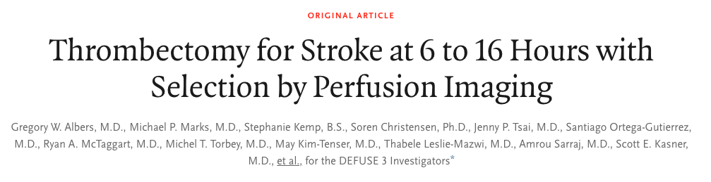
PROBE design
Patient selection:
  LNK 6-16h prior to randomization
  Premorbid mRS 0-1; NIHSS >6
  Infarct <70ml
  Ratio of perfusion:infarct mismatch on imaging
  Demonstrated occlusion of ICA, MCA M1 Stratified by age, NIHSS and infarct volume
  Broader selection (less severe, and larger infarctions) than DAWN
Notes:
DAWN was followed by the release of data from the concurrent and similar study, DEFUSE3;
Prospective, randomized open label, blinded end point design; 38 centers in US
Late presentation or wake up strokes
Minimal or no disability pre-stroke
Proximal large vessel only
“imaging mismatch” – CTP or MRP; RAPID software for CTP

Slide 81
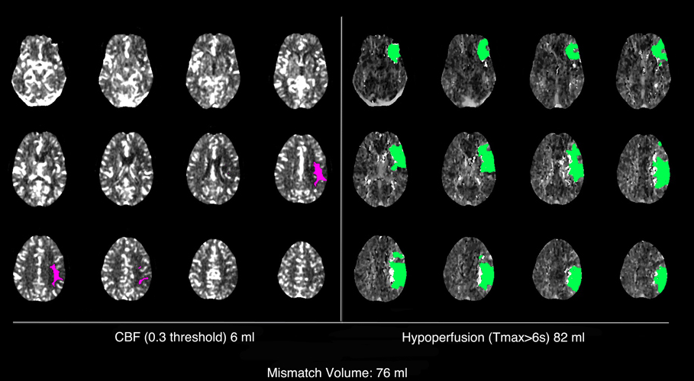
Patient selection:
  Ratio of perfusion:infarct mismatch on imaging
Notes:
“imaging mismatch” – CTP IschemiaView RAPID software for CTP

Slide 82

Treatment
  EVT + standard care vs Standard care alone
  Any device
  Stratified by core volume, NIHSS, age, LKN

Slide 83
Results
  Stopped early due to DAWN results
  182 patients

Slide 84


Slide 85
Results
  Functional independence at 90days: 45% vs 17%
  (RR2.67 (1.60-4.48) p<0.001)
    NNT 4
  Reperfusion (>90%) of initial perfusion lesion at 24h: 79% vs 18% (p<0.001)
  Recanalization @24h:
  78% vs 18% (p<0.001)

Slide 86
Safety Outcomes
  Mortality 14% EVT vs 26% medical (p=0.05)
  sICH 7% v 4% (p=0.75)
Notes:
Mortality and sICH were the same between groups (if anything a trend towards higher mortality in medical arm)

Slide 87
Results
  Benefit durable in all subgroups:
    9-12h from normal vs 12-16h
    Met DAWN enrollment criteria vs not
    Age
    NIHSS
Notes:
These were underpowered however, as trial was stopped very early

Slide 88
A New Dawn in Stroke Care
Other Considerations
  Only 1/3 of patients with a proximal anterior LVO who presents within 6-24h of LKN may meet the imaging criteria
  Use of CTP allows for use of a “tissue window” rather than a time window, which is more biologically plausible
Notes:
Which means realistically few raw number of patients who would be treated within this protocol (but possible many more transfers to big duke if we don’t have the imaging at Regional

Slide 89
A New Dawn in Stroke Care
Other Considerations
  Use of CTP allows for use of a “tissue window” rather than a time window, which is more biologically plausible
    DAWN mRS 0-2 49%
    DEFUSE3 mRS 0-2 45%
    HERMES meta-analysis mRS 0-2 46%
Notes:
Similar good otucome rates from the original 0-6 hour EVT trials compared to DAWN suggests this ‘tissue window’ metric is as good as a short time window measure

Slide 90
A New Dawn in Stroke Care
Other Considerations
  Use of CTP to select patients for stroke intervention had been attempted for almost two decades with varying success
  DAWN was unique in identifying a clinical severity to core infarct mismatch
  DEFUSE used penumbra vs core imaging criteria only, with a wider catchment of severity and core infarct size
  Two of the 6 early-window EVT trials which did use penumbral imaging, resulted in the highest ever rates of functional independence (60% and 71%)^{1,2}
1. Saver J et al. NEJM. 2015;372:2285–95
2. Campbell B, Mitchell P, Kleinig T, et al. NEJM. 2015;372:1009–18.
Notes:
Read bullets
So in effect, DAWN also does not use much of the ‘penumbral’ imaging information for pt selection – identifies the core infarct (already dead tissue) and if this is small compared to clinical deficits, uses that to suggest there is a lot of salvageable tissue.
Previous trials in the early window, which used penumbral imaging also, (EXTEND IA, SWIFT PRIME) resulted in excellent clinical outcomes, again suggesting that when used correctly and carefully this imaging may be useful in patient selection for interventions.

Slide 91
A New Dawn in Stroke Care
Other Considerations
  DEFUSE conducted at major StrokeNet centers with significant experience, specific imaging and software capabilities; may not be generalizable widely
Notes:
Read bullets
So in effect, DAWN also does not use much of the ‘penumbral’ imaging information for pt selection – identifies the core infarct (already dead tissue) and if this is small compared to clinical deficits, uses that to suggest there is a lot of salvageable tissue.
Previous trials in the early window, which used penumbral imaging also, (EXTEND IA, SWIFT PRIME) resulted in excellent clinical outcomes, again suggesting that when used correctly and carefully this imaging may be useful in patient selection for interventions.

Slide 92
History of Stroke Treatment
4.5h tPA window
EVT Works!
IV tPA
400BC
1995
2008
2015
2013
2017
EVT doesn’t
work
DAWN
DEFUSE3
Notes:
So let’s add that to our now exciting time line

Slide 93


Notes:
ISC 2018: The full DAWN and all of DEFUSE 3 data is revealed, and the same day, the AHA guidelines committee releases the new 2018 acute management of stroke guidelines…..to much controversy

Slide 94

2018 Stroke Guidelines:
The Controversy
Writing committee is very conservative
Data-driven to a fault
Recommended only practices directly shown in the literature to improve OUTCOMES
  Cardiac monitoring
  Imaging
Notes:
This next couple of slides are OPINION and do not reflect that of Duke University or all neurologists
1) Ovelry conservative in practice
2) Data driven to a fault – No RTC that shows parachutes save lives, but…
3) Lack of evidence is not evidence to the contrary; i.e. they recommended against long term cardiac monitoring which has robust data showing it captures more Afib – strictly because there hasn’t been a study that shows directly that long term cardiac monitoring improved pt outcomes…
4)

Slide 95

2018 Stroke Guidelines:
The controversy
AHA rescinded/deleted part of the guideline statements in Mid-April
  Without discussing w writing committee
  Statements deleted are unusual choices [ed]
Notes:
This next couple of slides are OPINION and do not reflect that of Duke University or all neurologists
AHA acted unilaterally
Statements deleted were not the ones which were most controversial at the AHA sessions
These are supposed to be ‘temporary’ while edits and changes are made
IMO these changes don’t change my clinical practice at all, and really shouldn’t anyone elses

Slide 96

2018 Stroke Guidelines:
New Classification Scheme

Slide 97

Selected New Guidelines

Slide 98

Selected 2018 Stroke Guidelines: tPA Administration
Faster is better; aim for <45min
1. Marler JR, et al. Early stroke treatment associated with better outcome The NINDS rt-PA Stroke Study. Neurology. 2000;55:1649–1655.

Slide 99


Selected 2018 Stroke Guidelines:
Imaging
IV tPA ALWAYS comes first, and should not be delayed by imaging
Do NOT need Creatinine/GFR prior to obtaining CTA
Get cervical vasculature imaging while you’re there, please

Slide 100


Selected 2018 Stroke Guidelines:
Imaging, II
<6 hours, advanced imaging is not recommended
6-24 hours, CTP, DW-MRI, MRI-P is recommended for pt selection for EVT
[ed] However, without dedicated software for interpretation, utility is limited

Slide 101

Selected 2018 Stroke Guidelines:
EVT Updates
For pts with LVO in 6-16h window (DEFUSE or DAWN criteria), EVT is recommended: 1A!
For pts with LVO in 16-24h window (DAWN criteria), EVT is reasonable: 2A

Slide 102
Other New Stroke Guideline Statements
Notes:
SKIP if out of time

Slide 103

Selected 2018 Stroke Guidelines:
Imaging, III
When an old MRI is available, a few CMBs is OK for tPA, >10, think again
Notes:
SKIP if out of time

Slide 104

Selected 2018 Stroke Guidelines: tPA, II
Antiplatelets may be used following tPA if the patient really needs it (recent cardiac stent)

Slide 105

Selected 2018 Stroke Guidelines:
EMS Triage
Benefit of EMS bypass to EVT-capable centers, in general, is uncertain
[ed] In selected patients this is reasonable and may become SOC for severe stroke
This was posted with a large section of caveats, along with saying the Mission:lifeline algorithm is ‘reasonable’
Local factors need to be factored in these decisions and all stakeholders should be engaged in planning management of AIS patients in any given region

Slide 106

Selected 2018 Stroke Guidelines:
EMS Triage
Mission:lifeline Stroke Triage algorithm is ‘reasonable’

Slide 107


Selected 2018 Stroke Guidelines:
Telestroke
Telestroke is effective for tPA decision making
IV tPA admin guided by telestroke is as safe and beneficial as it is within a stroke center
Telestroke is reasonable for triaging/determining eligibility for EVT

Slide 109
On The Horizon
WAKE-UP Trial
  Selection based on MRI imaging (DWI and FLAIR) to identify small core with likely recent onset even if LKN was 24h prior
  Stopped after interim analysis, but no data announced yet until ESOC 2018 meeting
ECASS 4
  Using MRI DWI and MRI Perfusion mismatch for selection of patients
Notes:
At least a couple of these are expected to be announced at ISC 2018 next month!

Slide 110

What’s next for the penumbra?
Faster diagnosis and treatment
Advanced systems of care
  IMPlementation of best PRactices fOr acute stroke care – deVEloping and optimizing regional systems of Stroke Care (IMPROVE Stroke Care)
Neuroprotection
  ACTION2 Trial
Alternative lytics and adjuvents
New secondary prevention agents
  PARFAIT Trial
Recovery/Rehab trials – stem cells
New devices
Increasing public awareness
Prevention

Slide 111

“Humanity’s greatest advances are not in its discoveries – but in how those discoveries are applied ...”
Bill Gates, June 7, 2007
Harvard Commencement Address

Slide 112

The Future of Acute Stroke Care is Bright
Thank you!
Questions?

Slide 113
APPENDICES

Slide 114

ASPECTS Score

Slide 115

NIHSS
Requires significant training
Assesses Severity
Skewed to LMCA strokes
Used by acute stroke team
for communication purposes

Slide 116
Cerebral Vasculature Review

Slide 117
Wall Street Journal- Feb 6, 2018
A Treatment Is Revolutionizing Stroke Care
But Not Everyone Receives It
The ‘thrombectomy’ is transforming stroke care, pre-empting brain damage in many patients, but the medical establishment is far from making it standard practice
Feb. 6, 2018 11:07 a.m. ET
By Thomas M. Burton

Slide 118

Notes:
Thrombectomy rates remain well below where they likely ought to be, and significantly so within stroke belt regions

