Slide 1
Treatment of Clostridium difficile Infection
Serina Tart, PharmD
Antimicrobial Stewardship Coordinator Clinical Pharmacist
Cape Fear Valley Health
start@capefearvalley.com

Slide 2
Disclosure
Disclosure
I no relevant financial disclosures.
I will be discussing off-label and investigational treatments in this presentation. I will disclose when that discussion occurs.
This activity has been planned and implemented in accordance with the Essentials and Standards of the North Carolina Medical Society through the joint sponsorship of the Southern Regional AHEC and Cape Fear Valley Hospital.
Southern Regional AHEC adheres to ACCME Essential Areas and Policies regarding industry support of continuing medical education. All those in a position to control content have disclosed and there are no unresolved conflicts prior to this program.
This program is not being supported by commercial funding.
I have no relevant financial relationships with the manufacturers of any of the products discussed in this CE activity
I will be discussing treatment options for Clostridium difficile infection (CDI) that are not FDA approved to treat this disease

Slide 3
Objectives
Describe the epidemiology and pathogenesis of Clostridium difficile Infection (CDI)
Review treatment guidelines
Discuss Fecal Microbiota Transplant (FMT)

Slide 4
C. Difficile Prevalence
Most common healthcare-associated infection (HAI) reported in 2011
Magill et al. N Engl J Med 2014; 370:1198-1208 Steiner et al. HCUP Projections Report 2014-01
Notes:
12.1% of 452 HAIs caused by CDI in 2011
Rates have risen through 2013

Slide 5
Estimated US Annual Burden
453,000 CDI cases
  293,000 healthcare associated
  160,000 community associated
29,000 deaths
$4.8 billion in excess healthcare costs
Estimated U.S. Burden of CDI, According to the Location of Stool Collection and Inpatient Health Care Exposure, 2011
Lessa et al. N Engl J Med 2015; 372(9):825-834 Dubberke et al. Clin Infect Dis 2012; 55:S88-92
Notes:
82% of community associated still with outpatient health care exposure

Slide 6
Changing Epidemiology
Increasing incidence
  antibiotic prescribing
Increasing severity
  BI/NAP1/027 virulent strain
Infection in “low risk” populations
  increased community onset
Notes:
North American Pulsed Field type 1 (NAP1), restriction endonuclease analysis (REA) type BI, polymerase chain reaction ribotype 027, referred to collectively as NAP1/BI/027 strain – more resistant to FQ, more severe disease and mortality, increased toxin production
Rates of CDI in the community are diff to assess, retrospective survey of cases in NC from 2005 est that 20% of CDI cases were community acquired. Cases in peripartum women have been documented. Rates also increasing in children

Slide 7
Pathogenesis of CDI
1. Patient ingests C. difficile spores
3. Normal flora altered by antibiotic use allows growth of C. difficile in the colon
2. Spores germinate in the intestine
4. Toxin A & B production leads to colon damage, diarrhea and pseudomembranous colitis

Slide 8
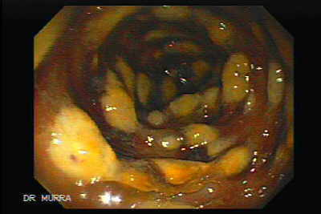
Toxin Production
Toxin A
  Enterotoxin
  Intestinal fluid secretion, mucosal injury, inflammation
Toxin B
  Cytotoxin
  Damage to human colonic mucosa
Pseudomembranous lesions
  Raised plaques
  Inflammation of surrounding mucosa
Bartlett JG. Ann Intern Med 2006. 145:758-764
Notes:
Additional toxins may play a role in virulence including binary toxins
Whitish-yellow raised plaques found in the colon, diagnosis can be make by colonoscopic visualization of these pseudomomembranes

Slide 9
Spectrum of Disease
Asymptomatic colonization
Mild to severe diarrhea (CDAD)
Severe, complicated disease
  Pseudomembranous colitis
  Toxic megacolon
  Perforation of the colon
  Septic shock
  Death

Slide 10
Assessment Question
Which of the following may cause CDI?
Clindamycin
Ceftriaxone
Levofloxacin
Metronidazole
All of the above

Slide 11
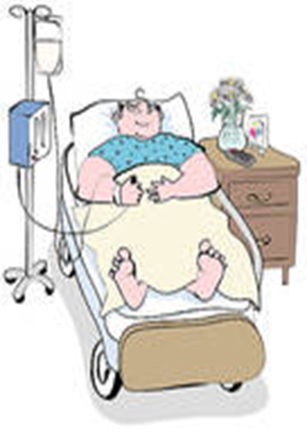
CDI Risk Factors
  Advanced age
  Duration of hospitalization
  Exposure to antimicrobials
  Comorbid conditions
  Immunosuppressed
  GI manipulation
  Acid suppressing agents: proton pump inhibitors (PPI)
Cohen SH, et al. Infect Cont Hosp Epidemiol 2010. 31(5):431-456
Notes:
11
Risk factors:
Advanced age: >65, also 5x greater risk of death
antibiotics – longer duration and multiple abx inc risk
Comorbid conditions: IBD, cancer
immunosuppressed – chemotherapy, HIV
GI – surgery, tube feeding
Acid suppressing agents, H2 blockers/PPI potential and controversial – more study is needed

Slide 12
Modifiable Risk Factors
Exposure to high risk abx | Exposure to spores | Gastric acid suppression
-Fluoroquinolones -3rd and 4th generation cephalosporins -Clindamycin -Carbapenems | -Spores can remain viable for 3 months -Room and home cleaning -Hand washing | -Evaluate for and discontinue unnecessary PPI use

Slide 13
Antimicrobial Stewardship
Exposure to any antimicrobial is the single most important risk factor for C. difficile infection (CDI)
Risk of CDI elevated during and 3 months following antimicrobial therapy
Target high risk antibiotics – de-escalate and avoid use when possible
Utilize shortest duration possible
Consider probiotic use

Slide 14
CDI Definition
Presence of diarrhea: 3 or more unformed stools in less than 24 hrs
Stool culture positive for presence of:
  Toxigenic C.difficile or its toxins or
  Pseudomembranous colitis found by endoscopy or histopathology
Cohen SH, et al. Infect Cont Hosp Epidemiol 2010. 31(5):431-456
Notes:
Limit testing to patients that meet this criteria: >3 liquid bowel movements in 24 hours, stool conforms to shape of container

Slide 15
Assessment Question
True/False?
Repeat C.difficile PCR testing should be performed to clear a patient from contact precautions.

Slide 16
Diagnosis
Clinical Suspicion
Lab tests:
  Toxin testing
  Antigen detection assays
  Stool culture (rare)
Diagnostic imaging
  Colonoscopy
  Computed tomography (CT) scan
Notes:
Stool culture – toxigenic culture – slow turn around time not clinically practical
Enzyme immunoassay (EIA) testing toxin A&B rapid but less sensitive
2 step method EIA detection of glutamate dehydrogenase (GDH) as initial screen then toxigenic culture as the confirmatory test (interim recommendation)
PCR – rapid and sensitive

Slide 17
C. difficile Testing
Test only unformed stool
Testing asymptomatic patients is not useful, including test of cure
Repeat testing during same episode of diarrhea should be discouraged
Clinical suspicion overrides negative results
Cohen SH, et al. Infect Cont Hosp Epidemiol 2010. 31(5):431-456
Notes:
17
Multiple stool specimens is not supported because of low increase in yield, possible false positives, not cost effective

Slide 18
Appropriate testing example algorithm

Slide 19
Special Enteric Contact Precautions
Gown and gloves
Wash Hands with Soap and Water
Alcohol foam does NOT kill spores
Disposable or dedicated equipment
Communicate contact precautions
Limit room transfers
Clean with sporicide

Slide 20
Assessment Question
Which medication should be used to treat severe CDI?
Fidaxomicin
Rifaximin
IVIG
Vancomycin
Metronidazole

Slide 21
Treatment Guidelines

Slide 22
Treatment Based on Severity
Infect Control Hosp Epidemiol 2010;31(5):431-455

Slide 23
Treatment Based on Severity
Clinical Definition | Clinical Data | Recommended Treatment
Initial episode, mild or moderate | WBC 15,000 cells/µL or lower and a SCr less than 1.5 baseline | Metronidazole 500mg PO TID for 10-14 days
Initial episode, severe | WBC 15,000 cells/µL or higher or a SCr greater than or equal to 1.5 baseline | Vancomycin 125mg PO QID for 10-14 days
Initial episode, severe complicated | Hypotension or shock, ileus, megacolon | Vancomycin 500mg PO/PR or NG QID, plus metronidazole 500mg IV q8hrs
Infect Control Hosp Epidemiol 2010;31(5):431-455

Slide 24
Metronidazole
Not FDA approved for CDI treatment
Poor pharmacologic profile
  Rapidly and almost completely absorbed
  6-15% excreted in stool
Oral administration preferred
500 mg PO/IV TID
Inexpensive
Notes:
Oral vanc first reported effective for cdad in 1978
1983 small but well designed clinical trial showed oral metronidazole to be equivalent to vanc
Early studies showed no difference in response or relapse rates between vanc and flagyl. Concerns for VRE and cost advantage led to metronidazole becoming preferred choice
Absorbed systemically side effects: GI upset, metallic taste, dizziness, disulfiram like reaction with alcohol, reversible but rare peripheral neuropathies and seizures may occur when high doses are given for long periods of time

Slide 25
Vancomycin
FDA approved for CDI
Only effective in oral or rectal form
  125 mg PO QID for initial episode
  500 mg PO or rectal enema QID with IV Flagyl for severe complicated disease
Ideal pharmacologic profile
  Poorly absorbed
  High fecal concentrations
Commercial formulation expensive
Notes:
Treatment recomm revised in 2007 pivotal study by Zar, et al, showed superiority of vanc for severe disease
Excellent activity against c.diff, doses of 125 qid result in fecal concentrations of >300mg/ml far exceeding the MIC

Slide 26
Fidaxomicin (Dificid ®)
Approved by the FDA May 27, 2011
Macrolide antibacterial bactericidal against C. difficile, inhibiting RNA synthesis
Indication: treatment of C. difficile associated diarrhea (CDAD) in adults
Studies showed less recurrence compared to oral vancomycin
Dose: 200 mg bid x 10 days
Expensive
N ENGL J MED 2011;364:422-31
Notes:
26
Vancomycin was the only drug approved for CDI until this

Slide 27
Other CDI Treatment Options
Rifaximin
Nitazoxanide
Tigecycline
Bacitracin
Probiotics
Immunotherapy (IVIG)
Fusidic acid*
Teicoplanin*
*not available in the USA
Toxin binding agents
Notes:
Cholestyramine – no demonstrable benefit and should be discouraged. Binds vancomycin, decreased efficacy
Bacitracin – expensive, generally should not be used

Slide 28
Patient Case: AT
AT is an 89 year old woman admitted with foul smelling, watery, diarrhea. She reports having 10 or more bowel movements each day. She recently finished a course of Cipro for a UTI.
WBC 18,000 SCr 1.4 Temp 100˚F
Home meds: Calcium with D daily, MVI, warfarin 2.5 mg MWF with 5 mg on other days, metoprolol 25 mg daily
Notes:
What severity classification
What would you treat her with?

Slide 29
Recurrent CDI
Rates of recurrence:
  20% after 1st episode
  45% after 2nd episode
  65% after 2 or more episodes
Am J Gastroenterol. 2002:97:1769-1775
Notes:
Recurrence is generally thought to be from residual spores and or failure to restore normal flora

Slide 30
Treatment of Recurrent CDI
Usually unrelated to resistance
Use the same agent
Treatment with metronidazole not recommended after 1st recurrence due to neurotoxicity
Cohen SH, et al. Infect Cont Hosp Epidemiol 2010. 31(5):431-456

Slide 31
Vancomycin Taper Example
Usual dose oral vancomycin 125mg 4 times per day for 10-14 days
Then oral vancomycin 125mg twice daily for one week
Then oral vancomycin 125mg once daily for one week
Then oral vancomycin 125mg every 2-3 days for 2-8 weeks
Cohen SH, et al. Infect Cont Hosp Epidemiol 2010. 31(5):431-456
Notes:
Multiple variations

Slide 32
Fecal Microbiota Transplant (FMT)
First reported FMT done 1958
Transfer of fecal bacteria from a healthy donor
Promotes recolonization of normal intestinal flora
FDA considers FMT an investigational new drug
  When used for CDI does not require IND application
):145-149
Notes:
Exact mechanism not known: replaces protective microbiome of natural colonic flora allowing suppression of C.difficile and possible immunological response
Enforcement discretion: when used for CDI FMT does not require an Investigational new drug application – if used for other indications would have to file

Slide 33
Which patient is NOT appropriate for FMT?
Septic patient in the ICU with toxic megacolon
Patient with severe CDI continuing to have profuse diarrhea on standard therapy
Patient hospitalized with a 4th recurrence of CDI

Slide 34
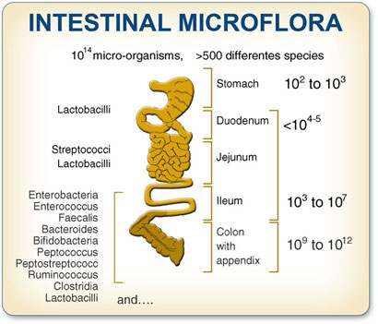
Gut Microbiota
100 trillion bacteria
Over 500 species
Colonization begins at birth
Many benefits: protect against invasive pathogens, produce vitamins, assist in digestion
Antibiotics disrupt microbial balance
http://thepowerofpoop.com Physiological Reviews. July 2010;90(3):859-904

Slide 35
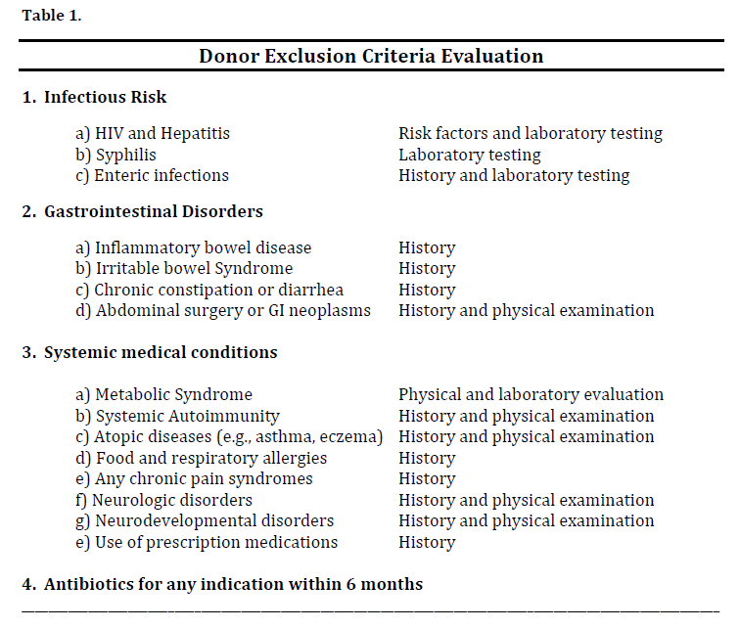
Donors
Often healthy family member
Screened for bacterial and parasitic infections
Screening is expensive – not covered by insurance
Stool banks provide convenience of regularly test donors
http://thepowerofpoop.com

Slide 36
FMT Risks
Common side effects: nausea, bloating, mild cramping
Aspiration
Acquiring infection from donor – rare
Complications from sedation and endoscopy: bleeding , perforation, transmission of other infections

Slide 37
Contraindications to FMT
Toxic megacolon
Anatomic contraindication to NGT and/or colonoscopy
Pregnancy
Severe immunosuppression
Critical illness or comorbid conditions
Need for antibiotics
Notes:
No true “contraindications” specified but probably should not be done in these patients

Slide 38
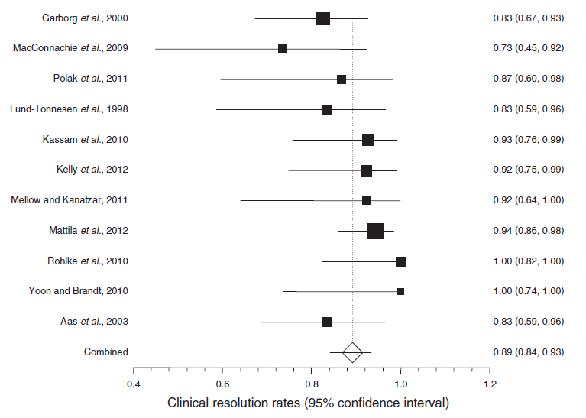
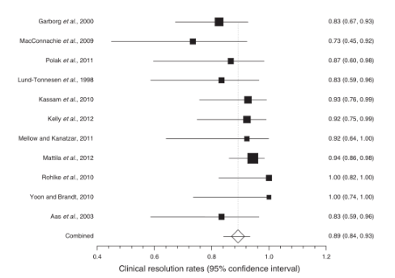
FMT Results
Meta analysis plot of weighted clinical resolution rates of fecal microbiota transplant in Clostridium difficile
Kassam, et al. Am J Gastroenterol. 2013 Apr;108(4):500-8
Notes:
Meta analysis - 11 studies included
245/273 patients experience clinical resolution
Lower GI administration trended toward higher clinical resolution than upper GI admin.
No difference in outcomes between anonymous and known donors
No adverse events reported

Slide 39
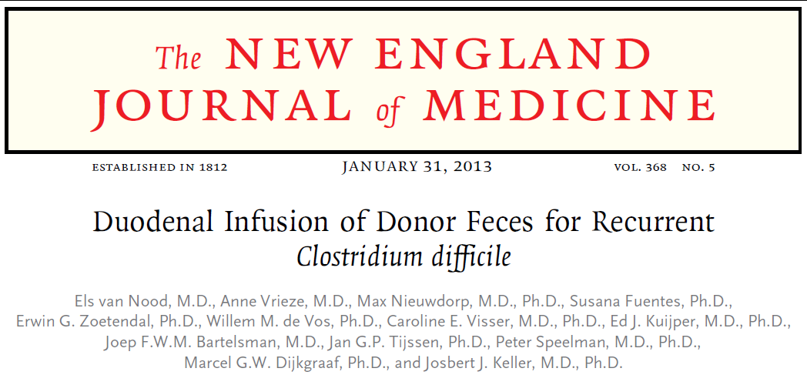
NEJM study
Infusion of donor feces significantly more effective than vancomycin
94% cure rate FMT, 31% vancomycin alone, 23% for vancomycin with bowel lavage (P<0.001 for overall cure rates)
Terminated early due to success of donor feces infusion
NEJM 368;5: 407-415
Notes:
Published after the meta-analysis was completed.
Small, open label study

Slide 40
FMT using Frozen Inoculum
Youngster, et al enrolled 20 patients with relapsing/refractory CDI
Used frozen stool suspension from unrelated donors – 10 via colonoscopy, 10 via NGT
14 (70%) resolution after single FMT
4 obtained cure after retreatment = overall cure rate 90%
NGT appeared as effective as colonoscopy
CID Advanced access published on line April 23, 2014
Notes:
No serious or unexpected adverse events
Bowel movements decreased from average of 7/day to 2/day the day after FMT

Slide 41
FMT at CFVHS
OpenBiome
  Nonprofit stool bank
  Strict quality and safety controls
  Frozen stool product, screened and ready to use
Routes: colonoscopy (250 mL), naso-enteric tube (30 mL), retention enema (250 mL)
Capsules: 30 frozen capsules swallowed in 90 minutes, physician must observe
www.openbiome.org/
Notes:
Very strict donor screening, testing results sent with sample
No consensus on most appropriate delivery method

Slide 42
FMT at CFVHS
Indications:
  At least 3 episodes of mild to moderate CDI not responding to standard therapy
  At least 2 episodes of severe CDI that required hospitalization
  Severe CDI that did not respond to antibiotics within 2 days
Requires Infectious Diseases or GI consult to evaluate patient for use and determine route
Notes:
Considered contraindicated if severe comorbid conditions or severe immunosuppression

Slide 43
FMT at CFVHS
Discontinue all antibiotics 48-72 hours prior to procedure
Administer Protonix night before and morning of procedure to neutralize pH
Optional bowel prep and loperamide
Diet/NPO restrictions and preparatory requirements depending on route
Pre and Post-FMT education provided to patient

Slide 44
Questions?

