Slide 1
Copyright Lisa Kilburn January 2022

Slide 2
What is copyrighted?
Original works of authorship as soon as an author fixes the work in a tangible form of expression.
paintings, photographs, illustrations, musical compositions, sound recordings, computer programs, books, poems, blog posts, movies, architectural works, plays, and so much more!
Copyright protects expression
Ideas, procedures, methods, systems, processes, concepts, principles, or discoveries are NOT copyrightable.
If it is published, it is likely copyrighted.
Notes:
https://copyright.gov/what-is-copyright/

Slide 3
Copyright versus Plagiarism
Copyright
“The exclusive legal right, given to an originator or an assignee to print, publish, perform, film, or record literary, artistic, or musical material, and to authorize others to do the same.” (Google definition from Oxford Languages, 9/17/21)
Legal standard
Plagiarism
“The practice of taking someone else's work or ideas and passing them off as one's own.” (Google definition from Oxford Languages, 9/17/21)
Ethical standard

Slide 4
Citations and Attributions
Citations satisfy plagiarism concerns
Many standard citation styles
APA, AMA, MLA, Turabian, etc.
Attributions are used for the copyright permission statements
No widely recognized, common standards
Best practices are beginning to emerge
Notes:
https://blog.apastyle.org/apastyle/2016/01/navigating-copyright-part-4.html

Slide 5
Some sources specify the format for copyright attribution
How should I acknowledge the American Medical Association in my work?
You must include the following copyright and permission notice in connection with any reproduction of the Licensed Material provide credit/attribution to the original publication – with full citation: "Reproduced with permission from [Journal Title. Year. Volume(Issue): page numbers or doi]. Copyright © (Year of Publication) American Medical Association. All rights reserved."

Slide 6
Generic attribution & permission statement
Citations with copyright attribution statement
Nutbeam D, McGill B, Premkumar P. Improving health literacy in community populations: a review of progress. Health Promot Int. 2018;33(5):901-911. doi:10.1093/heapro/dax015. Used with permission.
Other variations
Printed by permission of …
Reprinted with permission. All right reserved.
Adapted with permission
Reproduced by permission from …

Slide 7
Fair Use
Fair use is a legal doctrine that promotes freedom of expression by permitting the unlicensed use of copyright-protected works in certain circumstances.
Fair use activities: Criticism, comment, news reporting, teaching, scholarship, and research
Must consider:
Purpose and character of the use, including whether the use is of a commercial nature or is for nonprofit educational purposes
Nature of the copyrighted work
Amount and substantiality of the portion used in relation to the copyrighted work as a whole
Effect of the use upon the potential market for or value of the copyrighted work

Slide 8
Creative Commons License
Sørensen K, Van den Broucke S, Fullam J, et al. Health literacy and public health: a systematic review and integration of definitions and models. BMC Public Health. 2012;12:80. Published 2012 Jan 25. doi:10.1186/1471-2458-12-80. CC BY 2.0.
Notes:
https://blog.apastyle.org/apastyle/2016/01/navigating-copyright-part-4.html

Slide 9
Public Domain
What Is Health Literacy? Centers for Disease Control and Prevention. Last reviewed May 19, 2021. Accessed September 20, 2021. https://www.cdc.gov/healthliteracy/learn/index.html. Public domain.
Other options:
Courtesy of …
Notes:
https://blog.apastyle.org/apastyle/2016/01/navigating-copyright-part-4.html

Slide 10
Examples

Slide 11
Image is Copyrighted
Notes:
Image has no statement of copyright permission. Research online shows the author claims copyright over the image.

Slide 12
Image Published with Creative Commons License
Cam Good. Shcool. Flickr. https://www.flickr.com/photos/talweblog/2230817295. Taken on January 30, 2008. Accessed September 20, 2021. CC BY-NC-SA 2.0.

Slide 13
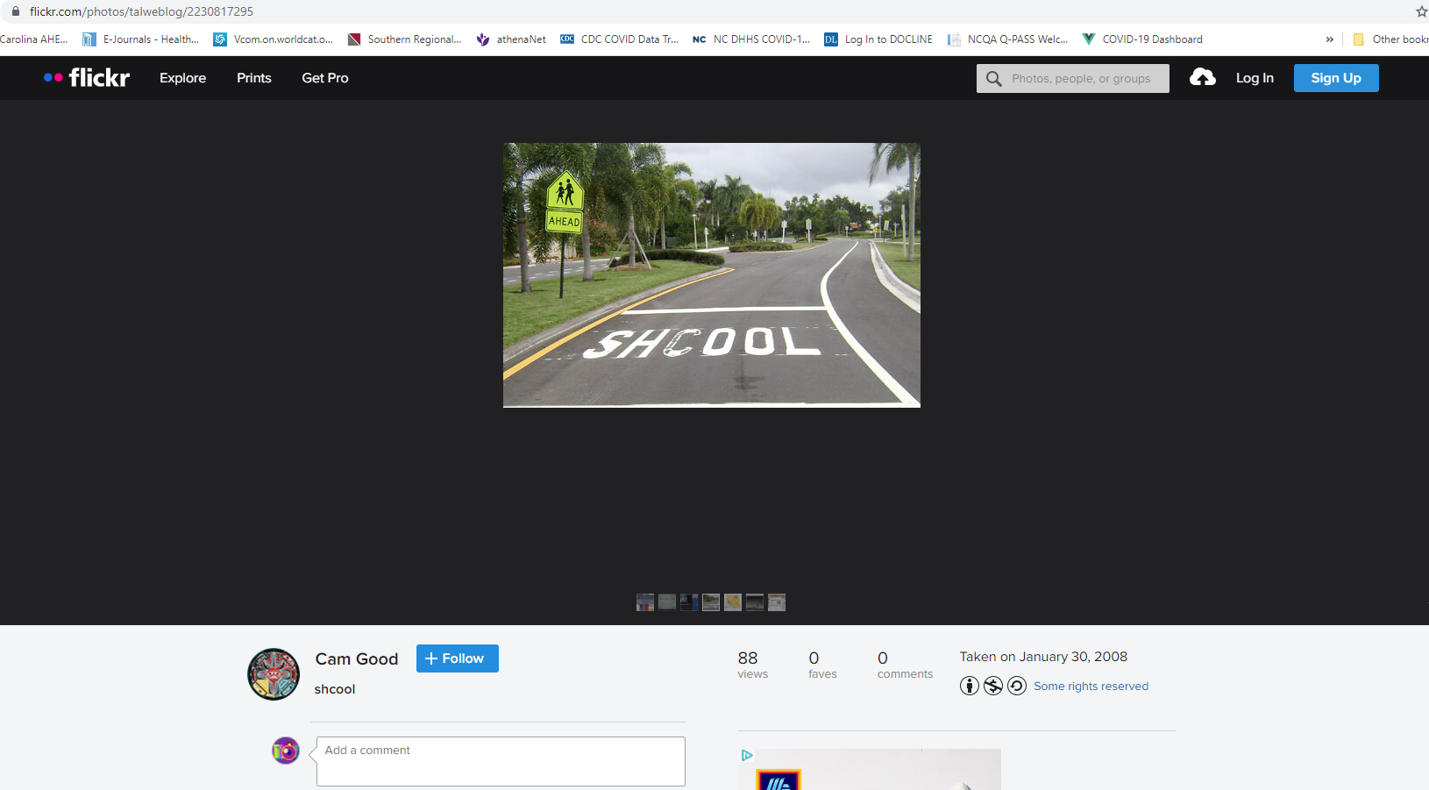
Screenshot of image source

Slide 14
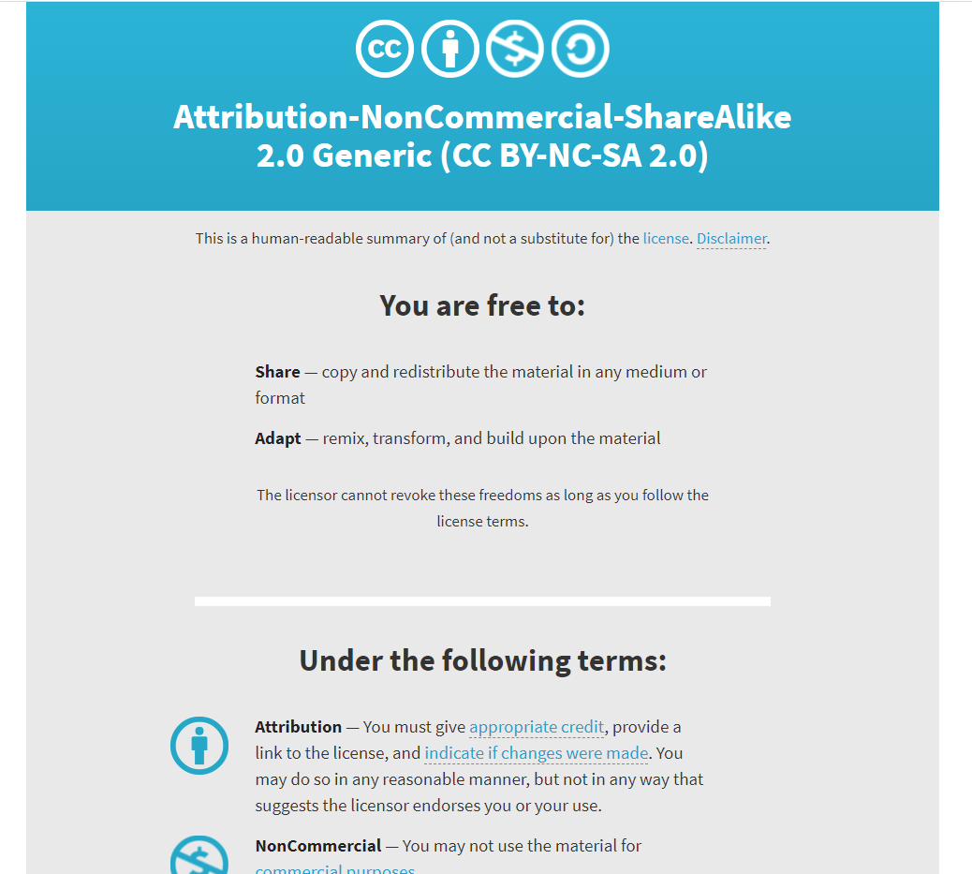
Screenshot of CC license

Slide 15
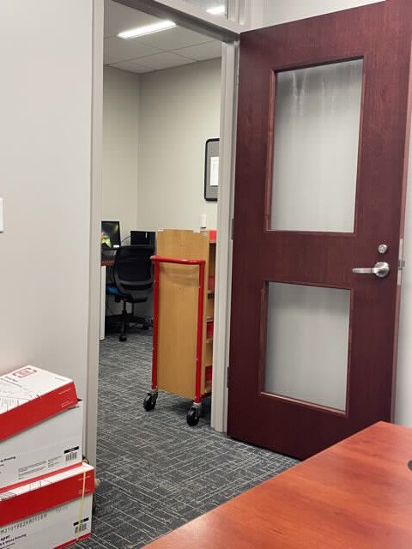
Alternate option: Take you own picture
Photo by author

Slide 16
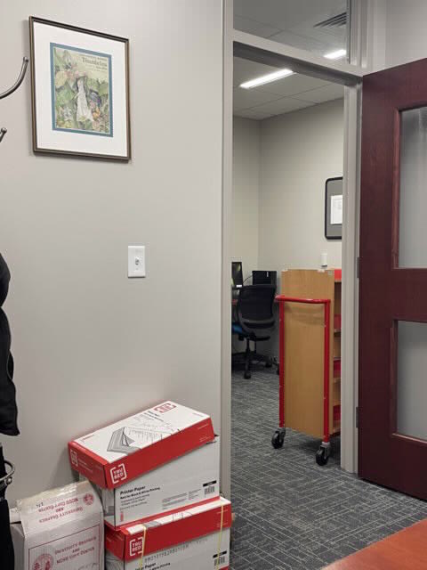
Don’t Take Pictures of Copyrighted Works
Photo by author

Slide 17
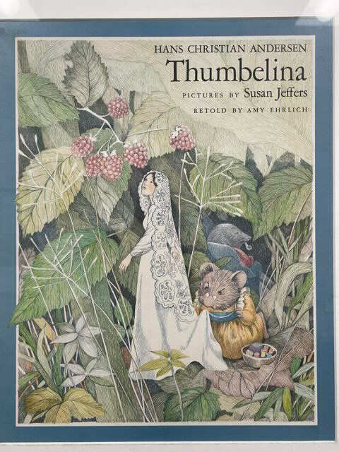
Re-use has to be “transformative.” This photo is not transformative.
Photo by author

Slide 18
This photo might be transformative.
Photo by author
“Transformative” uses are more likely to be considered fair. Transformative uses are those that add something new, with a further purpose or different character, and do not substitute for the original use of the work.

Slide 19
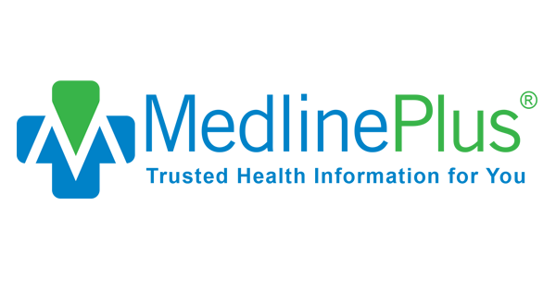
Logos
Logos are trademarked
Can be used to identify the organization for commentary or reporting
Cannot be used to misrepresent the organization
Logos are sometimes also copyrighted
If the logo is also copyrighted, user must request permission for use

Slide 20
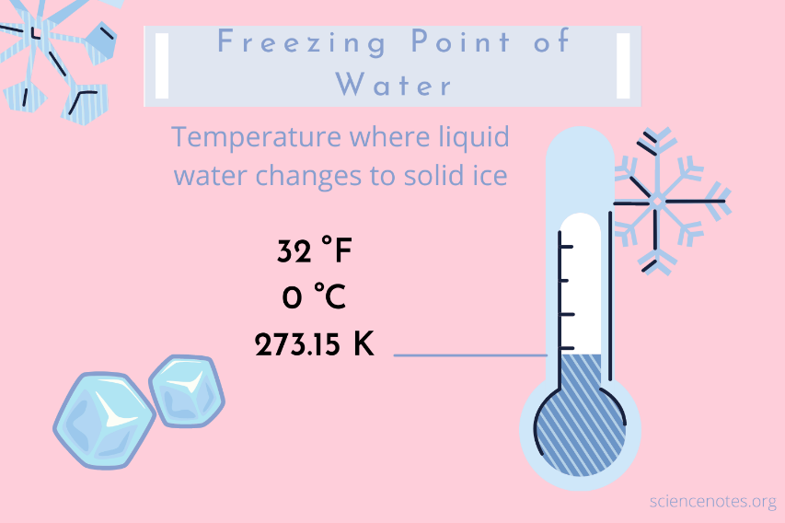
Factual information
Factual information cannot be copyrighted.
Example: The freezing point of water is 32° Fahrenheit or 0° Celsius.
The presentation of factual information is copyrighted.

Slide 21
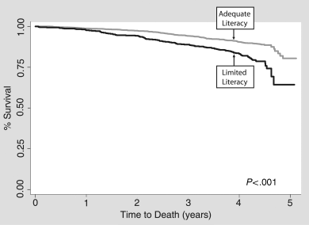
Graphs and Tables are Copyrighted
J Gen Intern Med. 2006 Aug;21(8):806-12.
Notes:
2512 community dwelling older adults without dementia. Limited literacy = less than 9th grade reading level. 23% of study participants had limited literacy. Those with limited literacy had a higher mortality rate 19.7% compared to 10.6% for those with adequate literacy.

Slide 22
Alternate presentation of data
Limited literacy and mortality in the elderly: the health, aging, and body composition study.
Absolute increased risk of death of 9% over 5 years.
Still significant after adjusting for:
Age, race, gender, income, education,
Co-morbidities and self-rated health status
Smoking, alcohol intake
Health care access, lack of insurance,
Depression, poor personal mastery
Health, Aging, and Body Composition Study
Source data: J Gen Intern Med. 2006 Aug;21(8):806-12.

Slide 23
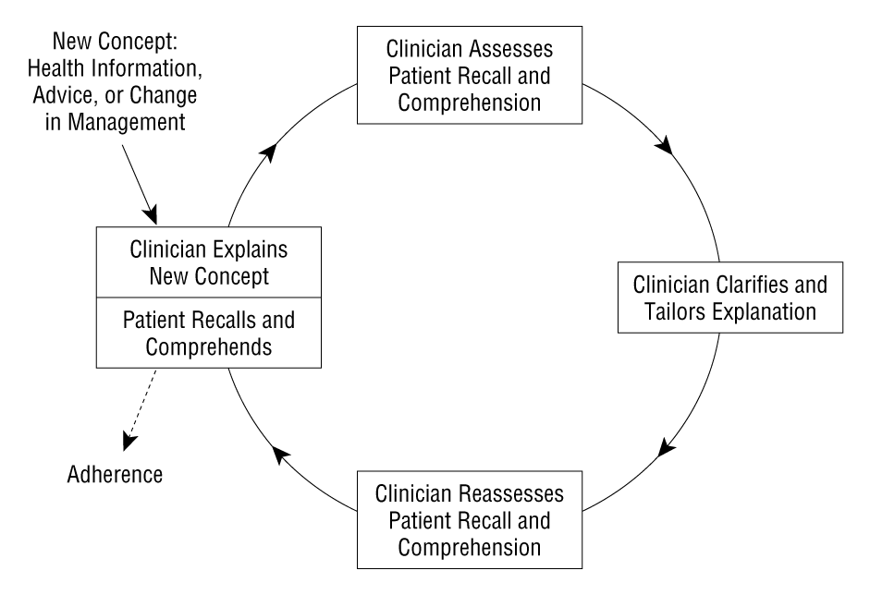
Seek the original source
Arch Intern Med. 2003 Jan 13;163(1):83-90.
Notes:
At it’s best, teach-back is a circle. The clinicians explains new information and then assesses understanding and recall. If the clinician needs to re-explain, it is important to remember to re-assess. And keep going around the circle until the patient mastered the information.

Slide 24
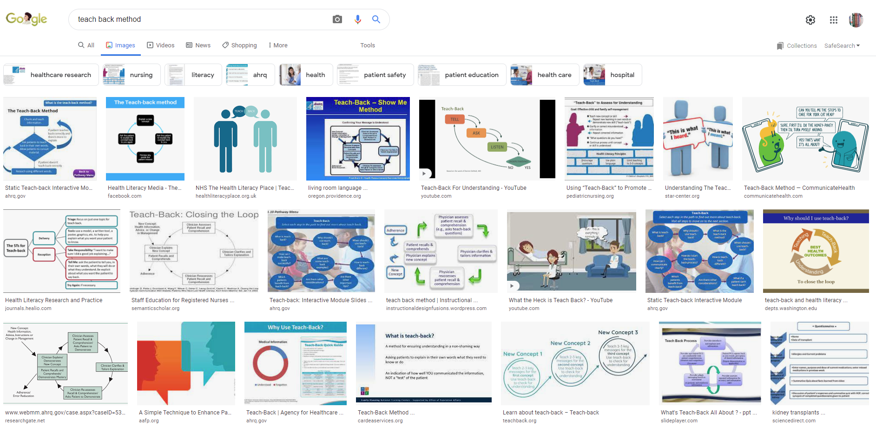
Just because you can find the image/graph/table online, does not mean you can use it.

Slide 25
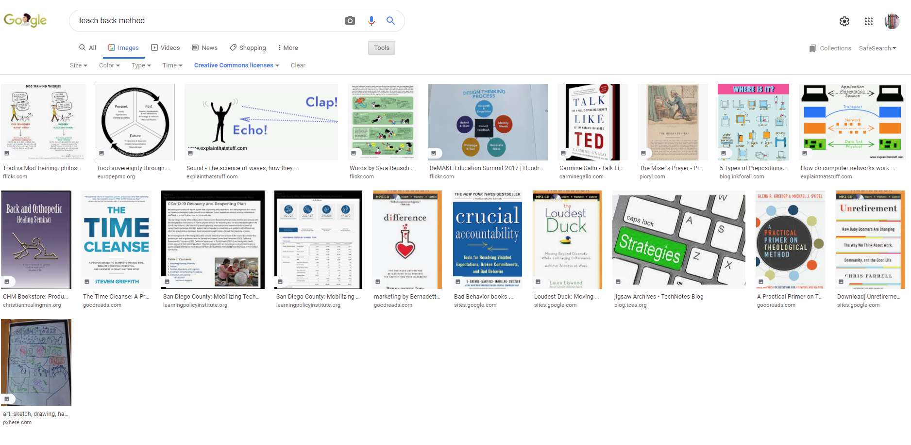
Search for image with a Creative Commons license

Slide 26
Create your own graph or image
Explain new concept
Listen
Clarify
Ask
Agreement

Slide 27
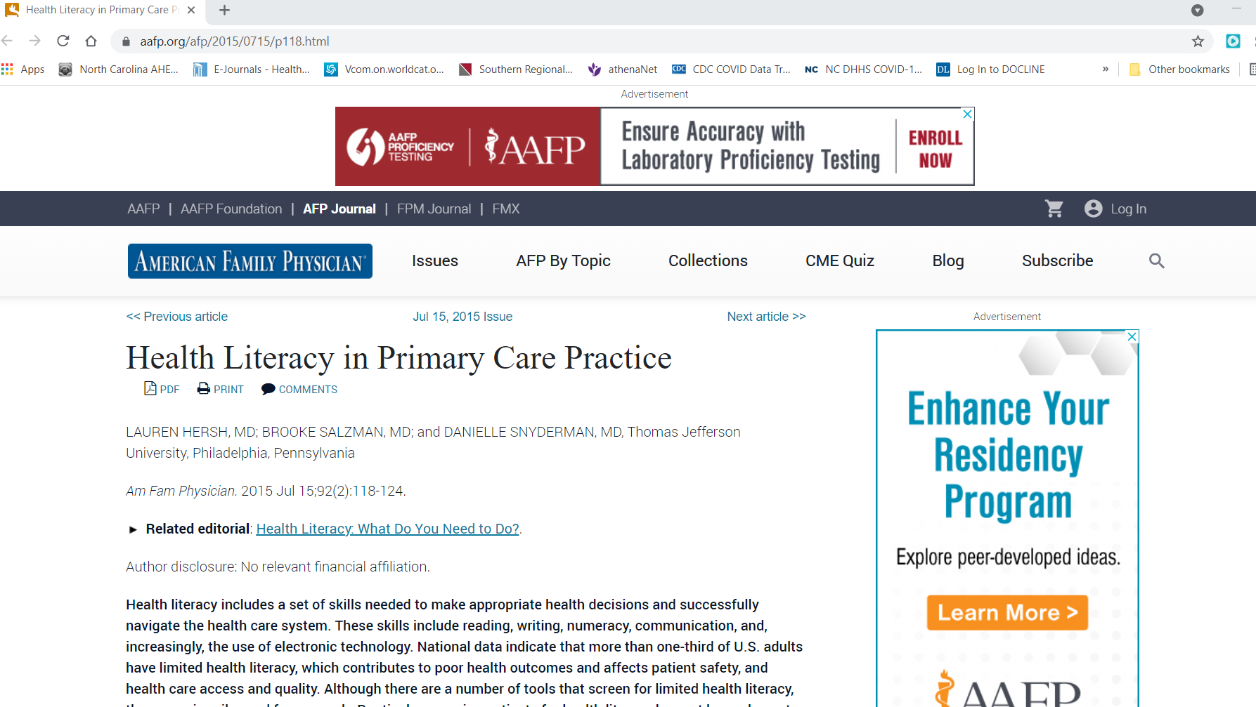
Open Access is not free to re-use

Slide 28
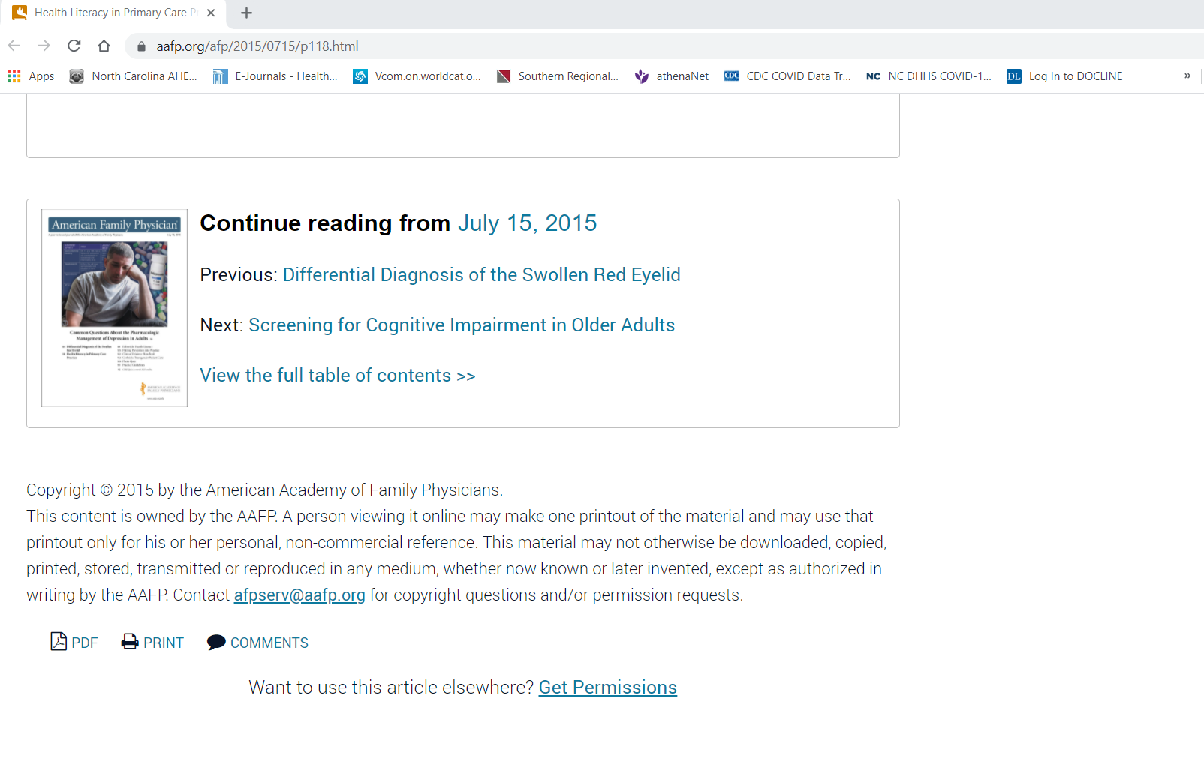
Read the fine print

Slide 29
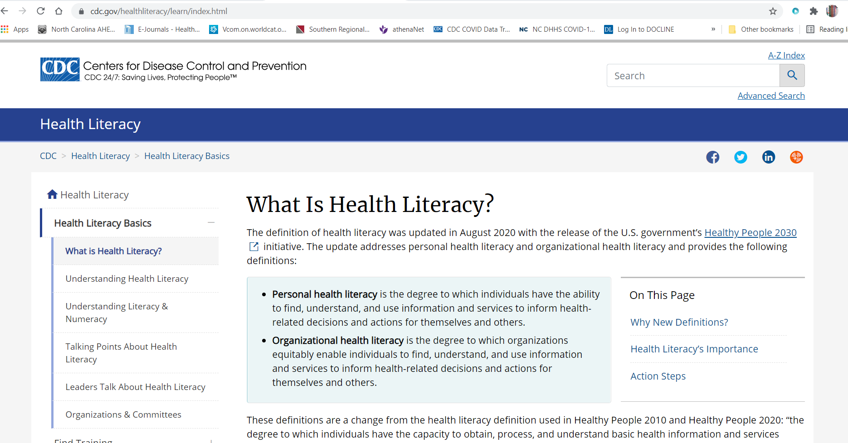
Federal government publications are usually public domain

Slide 30
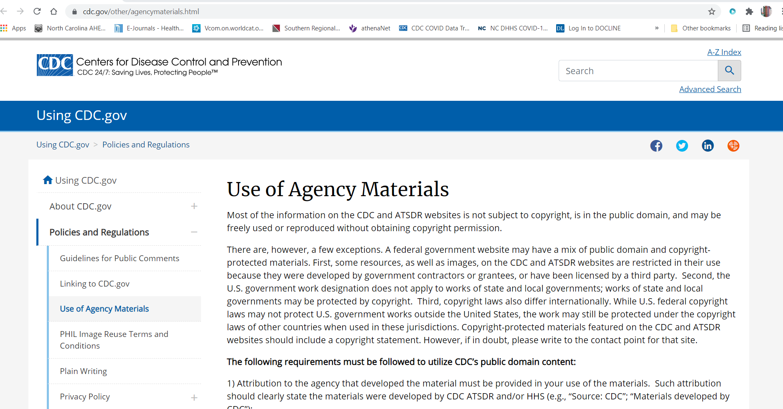
Read the fine print anyway

Slide 31
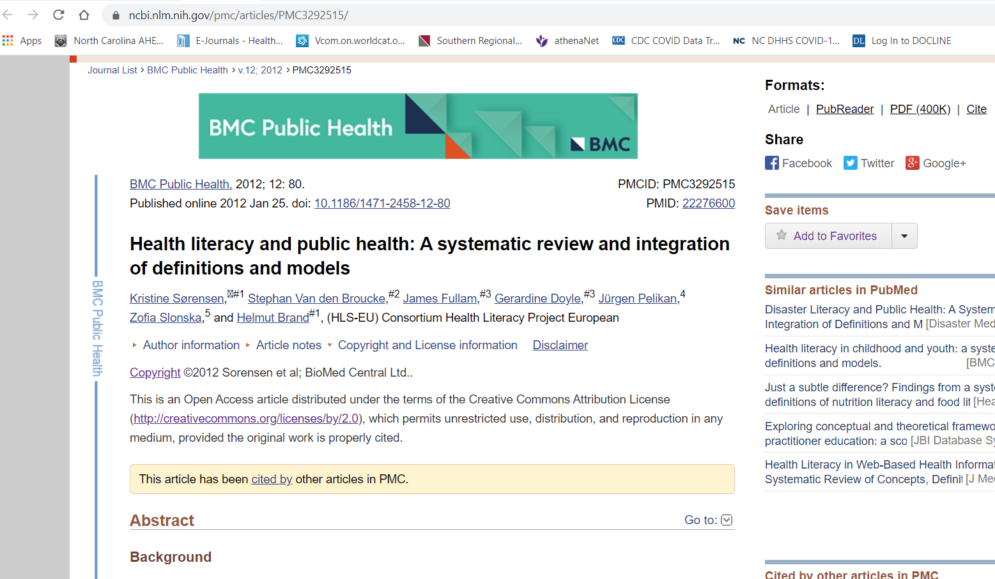
Open Access is sometimes published under a Creative Commons License

