Slide 1
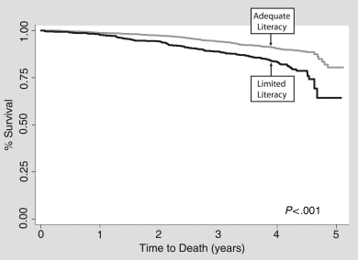
Literacy and Mortality
Copied chart:
Copyright Violation
J Gen Intern Med. 2006 Aug;21(8):806-12.
Notes:
2512 community dwelling older adults without dementia. Limited literacy = less than 9th grade reading level. 23% of study participants had limited literacy. Those with limited literacy had a higher mortality rate 19.7% compared to 10.6% for those with adequate literacy.
Sudore RL, Yaffe K, Satterfield S, et al. Limited literacy and mortality in the elderly: the health, aging, and body composition study. J Gen Intern Med. 2006;21(8):806-812. doi:10.1111/j.1525-1497.2006.00539.x

Slide 2
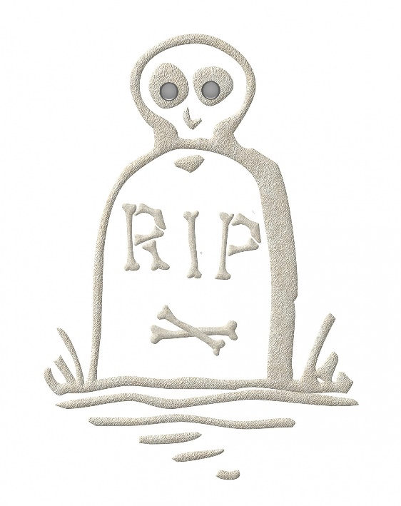
Low Literacy and Mortality
Legal:
written data summary
Limited literacy and mortality in the elderly: the health, aging, and body composition study.
  Absolute increased risk of death of 9% over 5 years.
Still significant after adjusting for:
  Age, race, gender, income, education,
  Co-morbidities and self-rated health status
  Smoking, alcohol intake
  Health care access, lack of insurance,
  Depression, poor personal mastery
Health, Aging, and Body Composition Study
Gallant C. Rip 2.
Source data: J Gen Intern Med. 2006 Aug;21(8):806-12.
Notes:
Sudore RL, Yaffe K, Satterfield S, et al. Limited literacy and mortality in the elderly: the health, aging, and body composition study. J Gen Intern Med. 2006;21(8):806-812. doi:10.1111/j.1525-1497.2006.00539.x
Gallant C. Rip 2. Public Domain Pictures. https://www.publicdomainpictures.net/en/view-image.php?image=259952&picture=rip-2. Accessed Oct. 28, 2021. CC0 Public Domain.

Slide 3
Literacy and Mortality
Legal:
recreation of the chart
9% absolute increased risk of death
Source data: J Gen Intern Med. 2006;21(8):806-812.
Notes:
Sudore RL, Yaffe K, Satterfield S, et al. Limited literacy and mortality in the elderly: the health, aging, and body composition study. J Gen Intern Med. 2006;21(8):806-812. doi:10.1111/j.1525-1497.2006.00539.x

